Slide 1
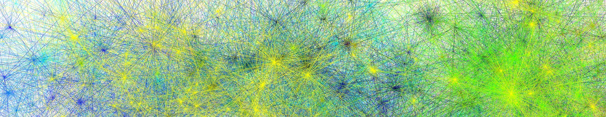

Psycholinguistic megastudies: Background and methods
James Brand
Charles University
james.brand@ff.cuni.cz
20/02/24, Conducting Experimental Research Online

Slide 2

Background
Processing
Norms
Conclusions
Megastudies

Slide 3



Background
Processing
Norms
Conclusions
Traditional studies
item1, item2, … item_{n} n = >10 and <100

Slide 4
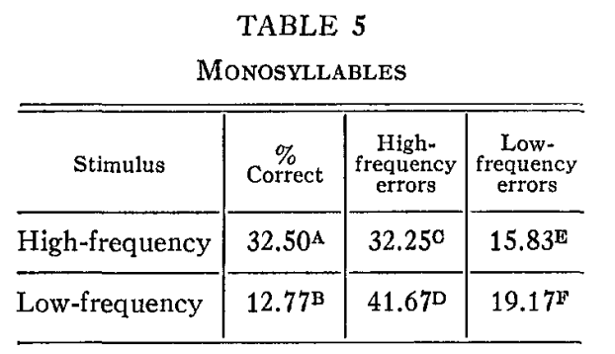
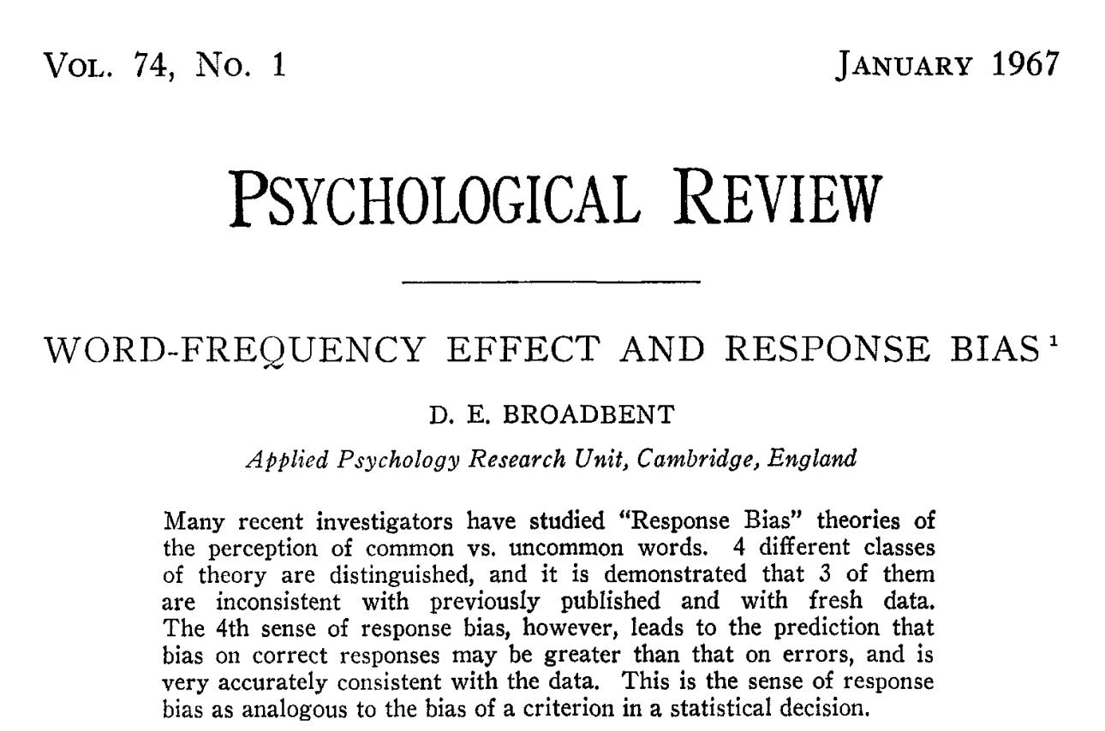
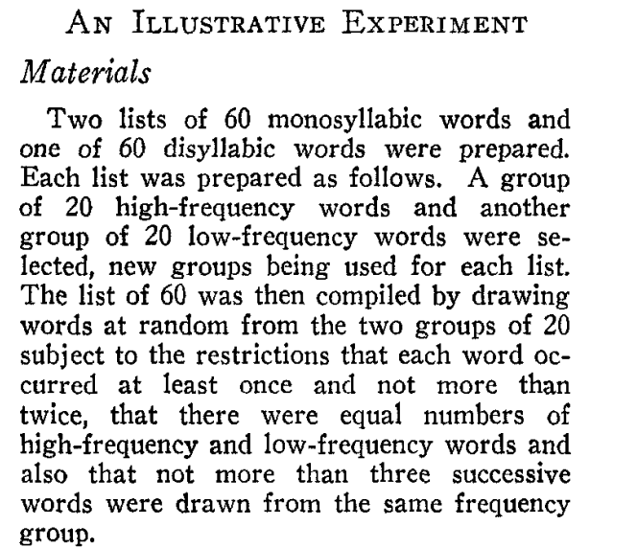
Background
Processing
Norms
Conclusions
Traditional studies

Slide 5
Background
Processing
Norms
Conclusions
Traditional studies
Factorial designs
Small numbers of stimuli
Over-generalisation of variables
Same design, different stimuli
accuracy
More items = more insight?
More items = more standardised?
low
high
frequency

Slide 6

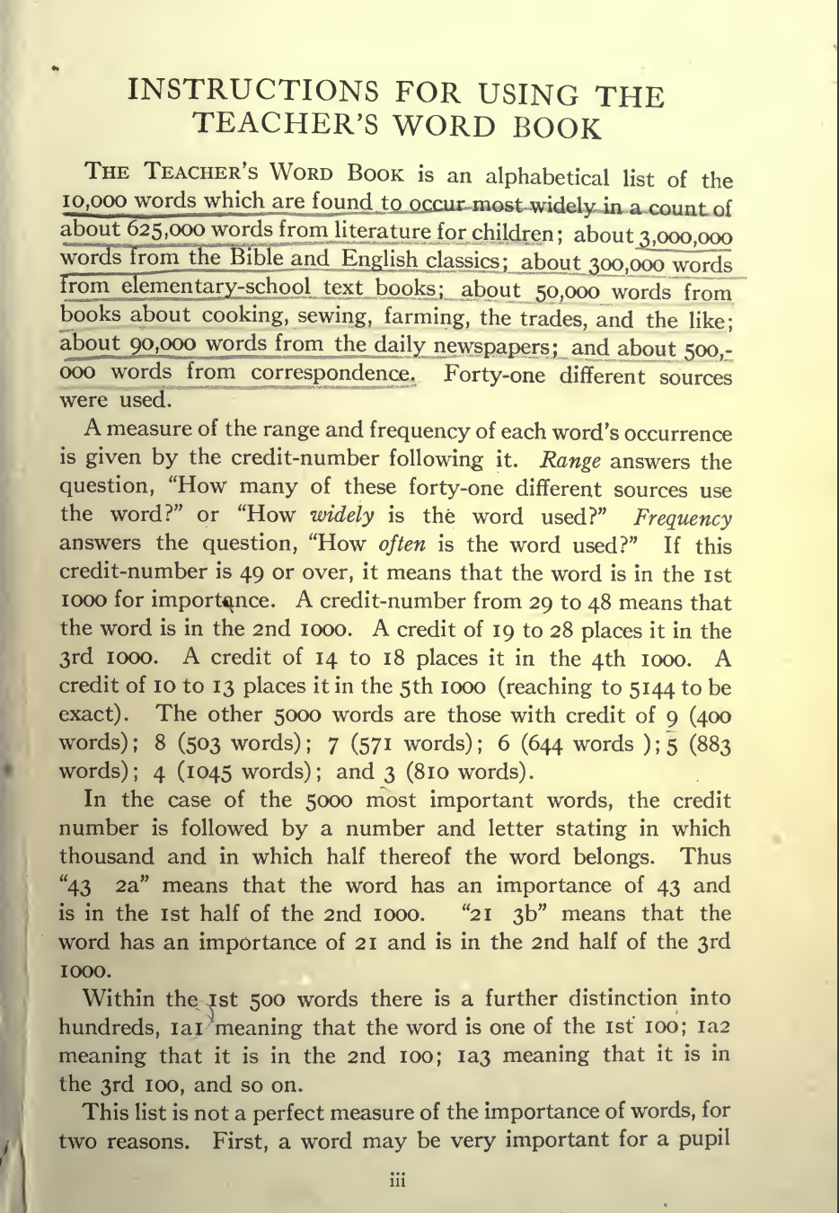
Background
Processing
Norms
Conclusions
Megastudies

Slide 7
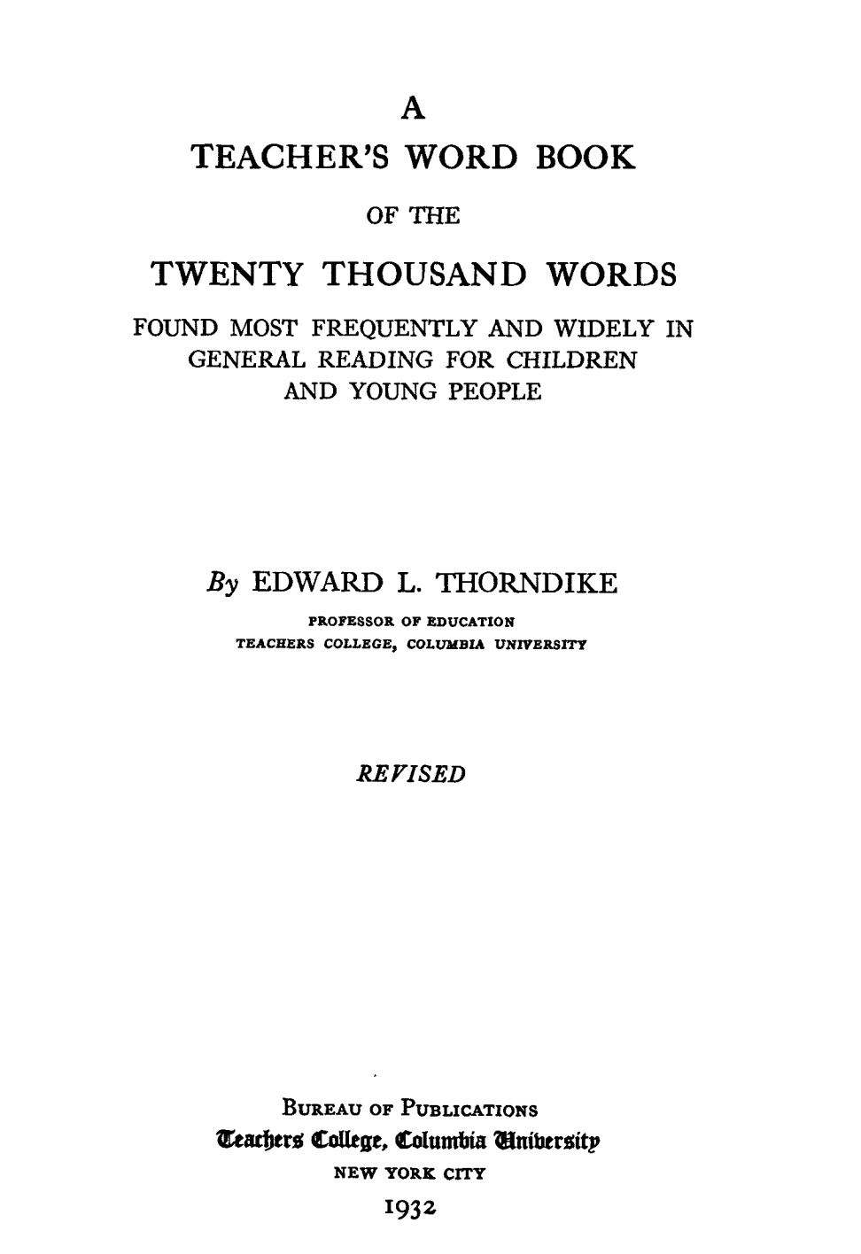
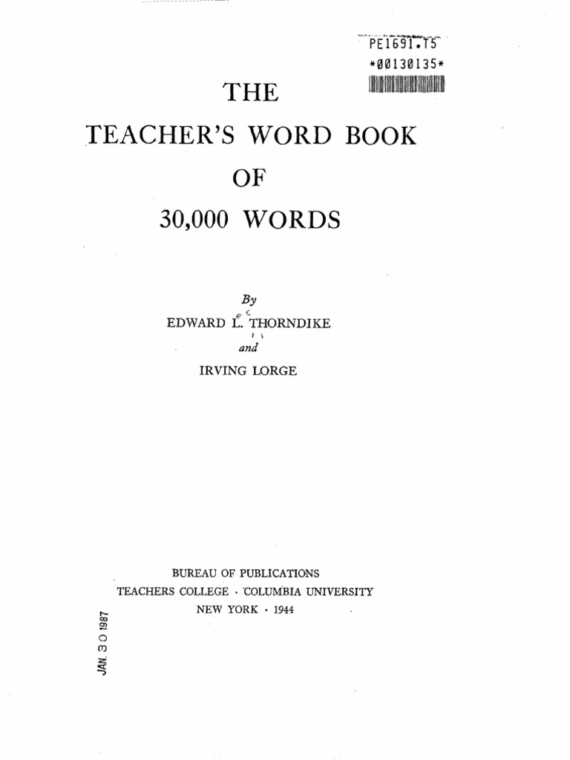
Background
Processing
Norms
Conclusions
Megastudies
1921
1932
1944

Slide 8
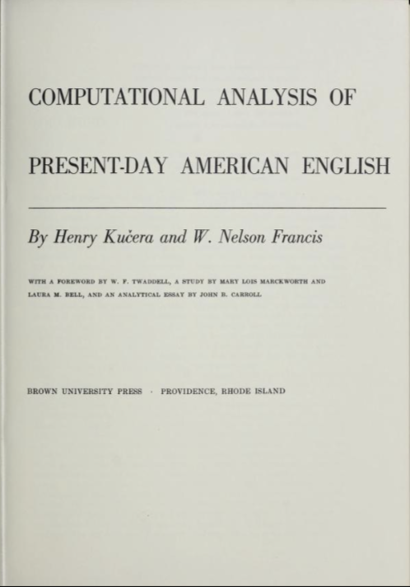
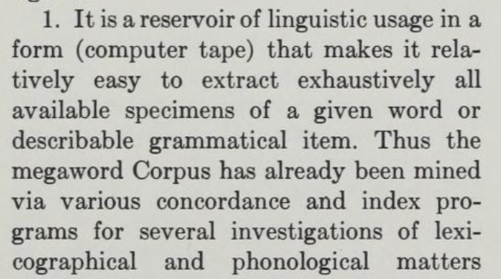
Background
Processing
Norms
Conclusions
Megastudies
1967

Slide 9
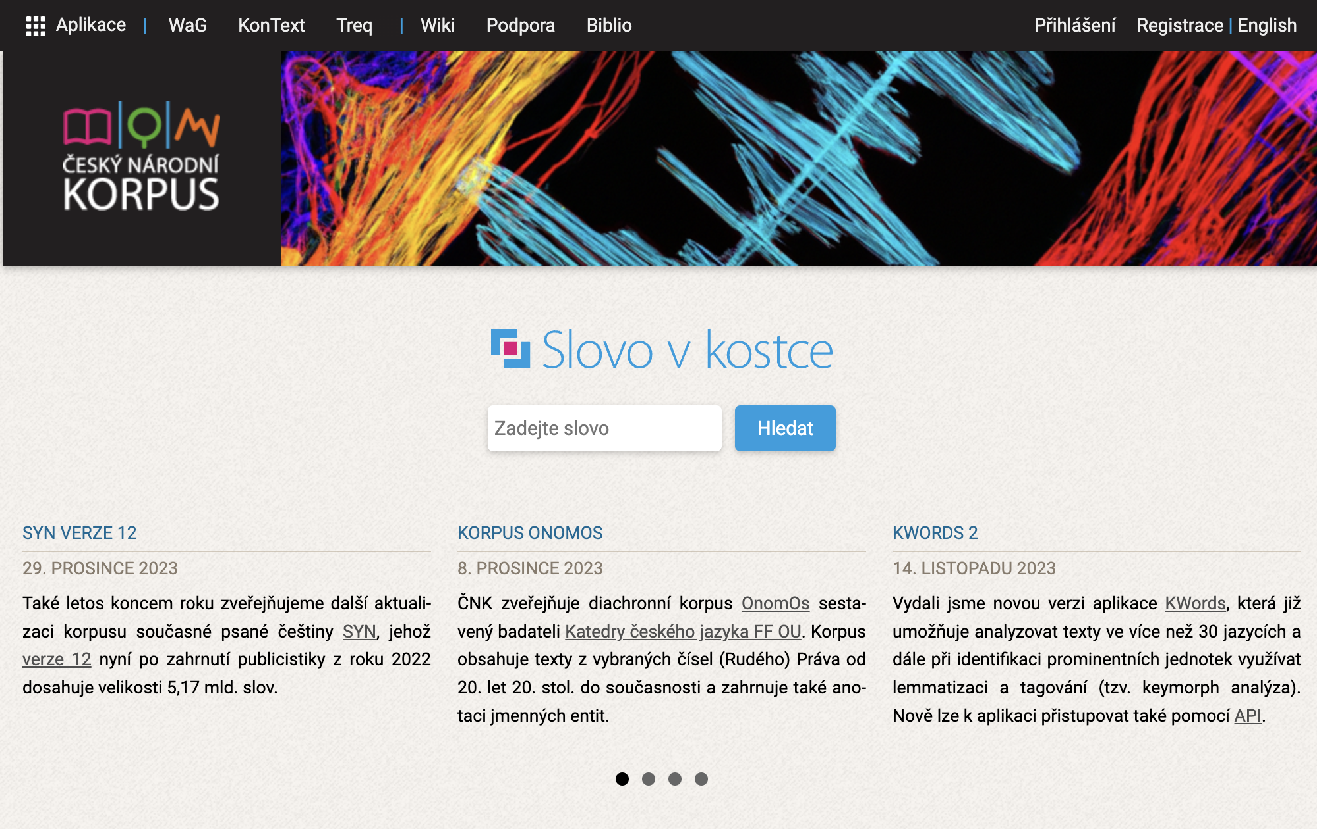
Background
Processing
Norms
Conclusions
Megastudies

Slide 10

Background
Processing
Norms
Conclusions
Megastudies
item1, item2, … item_{n} n = thousands

Slide 11
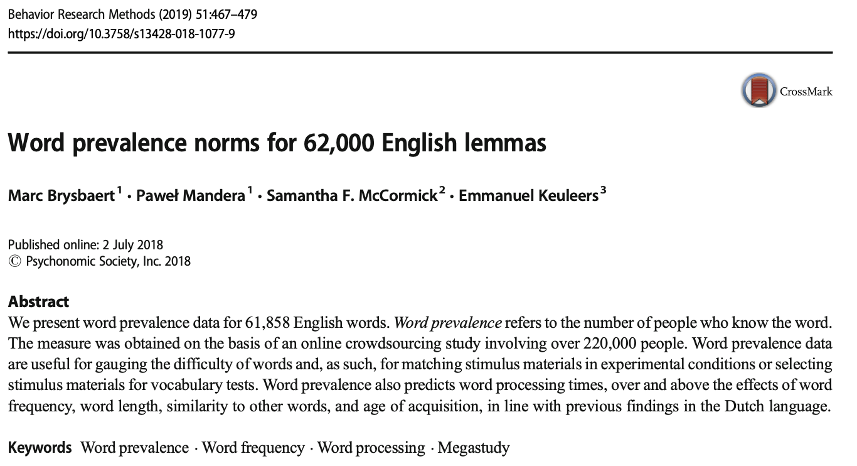
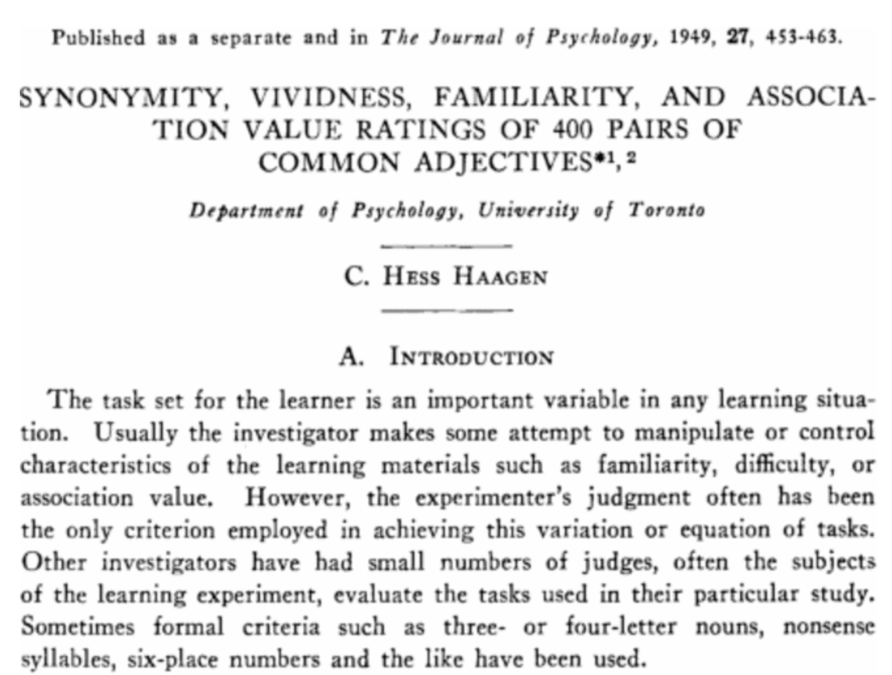
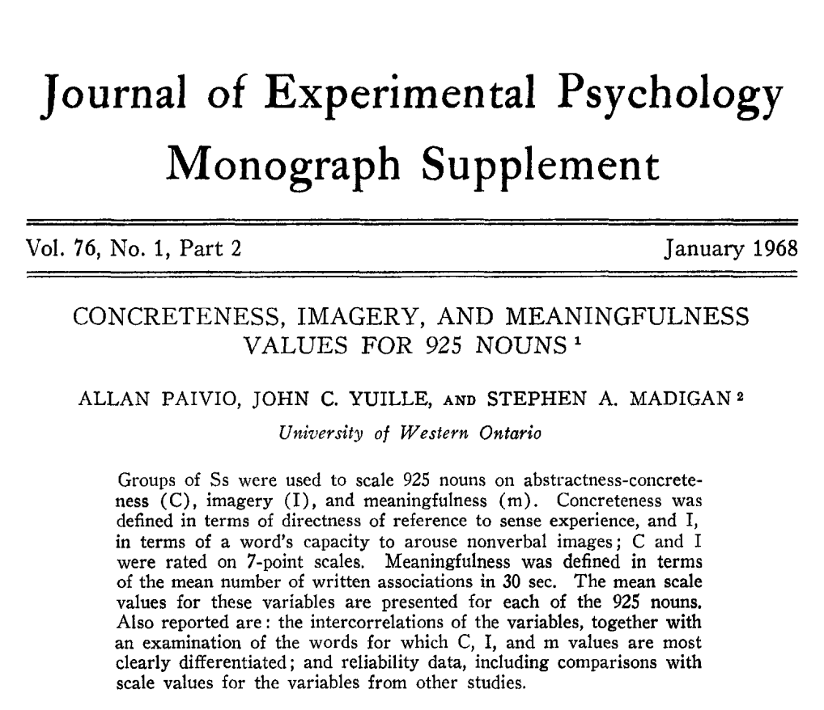
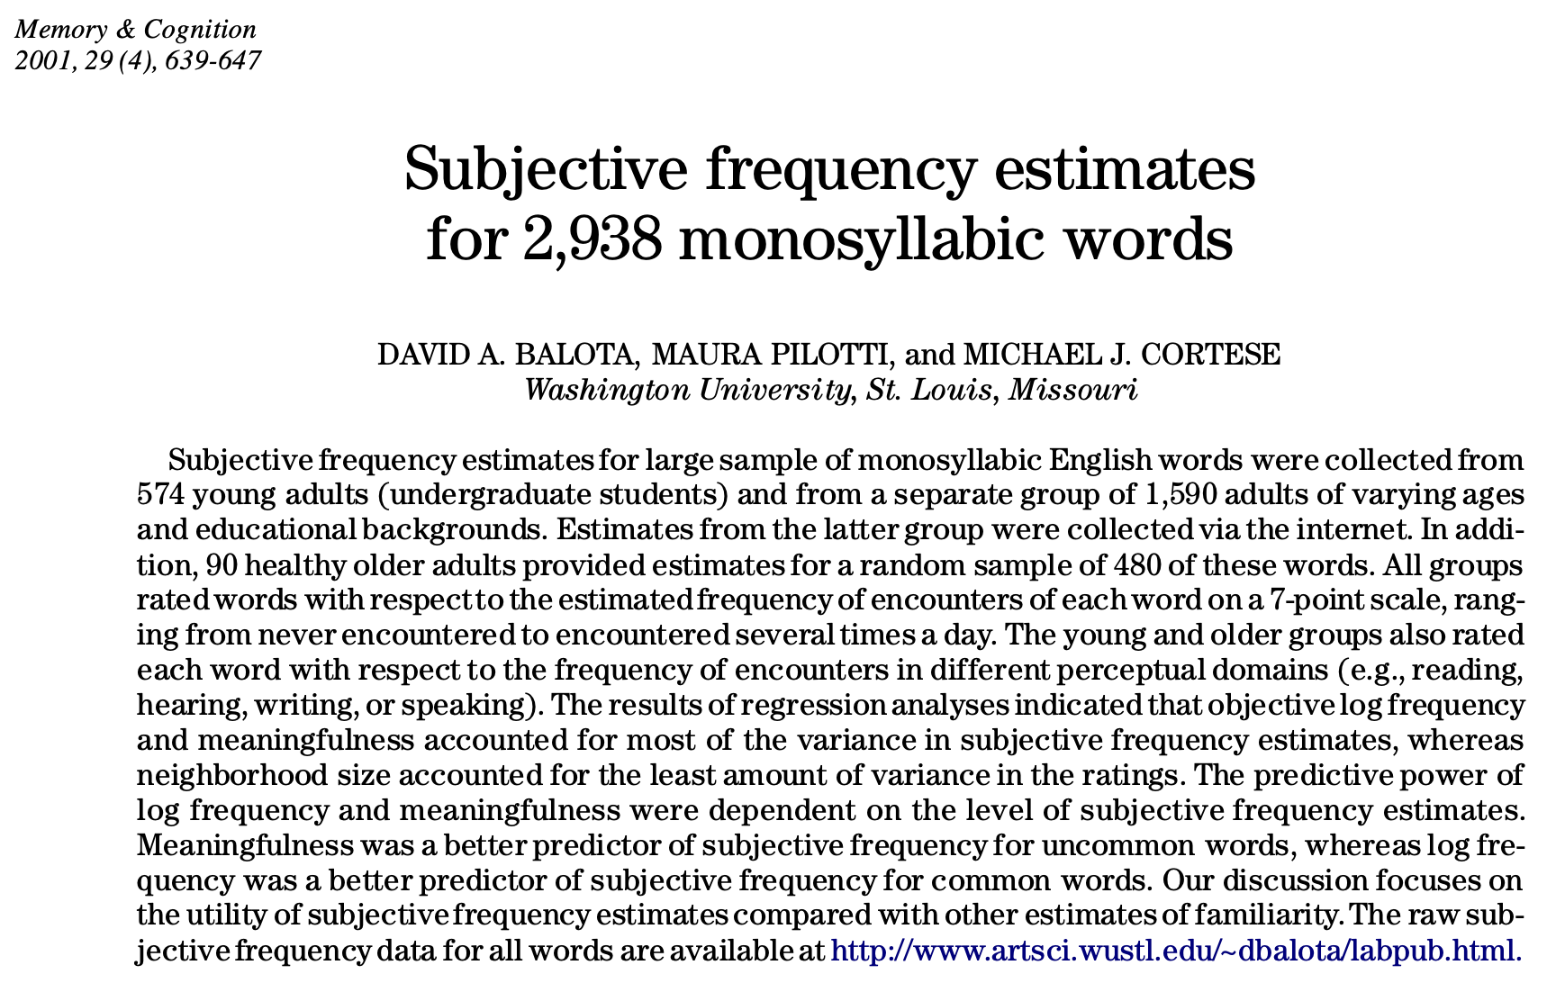
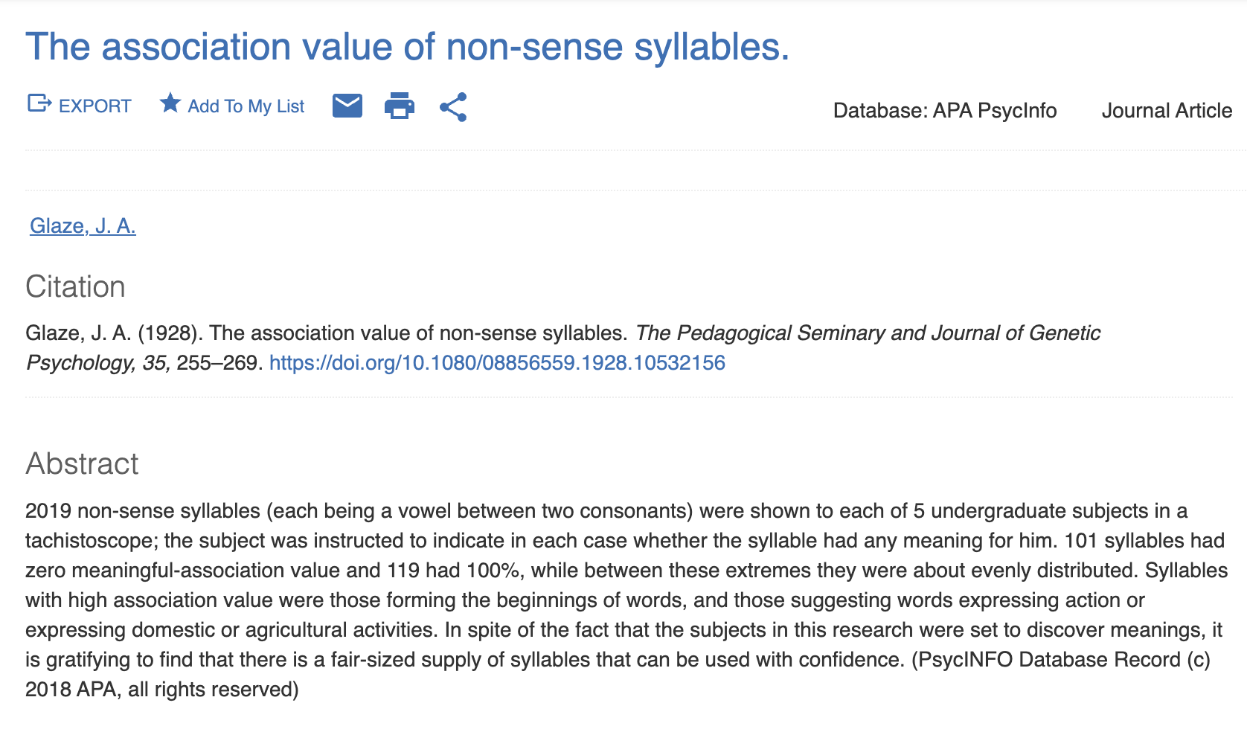
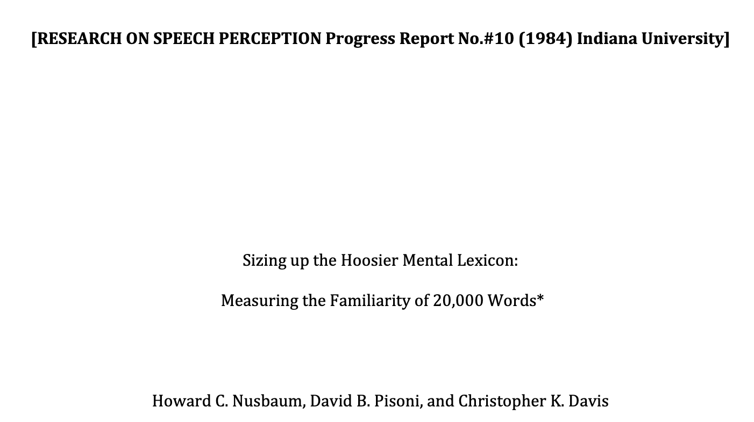
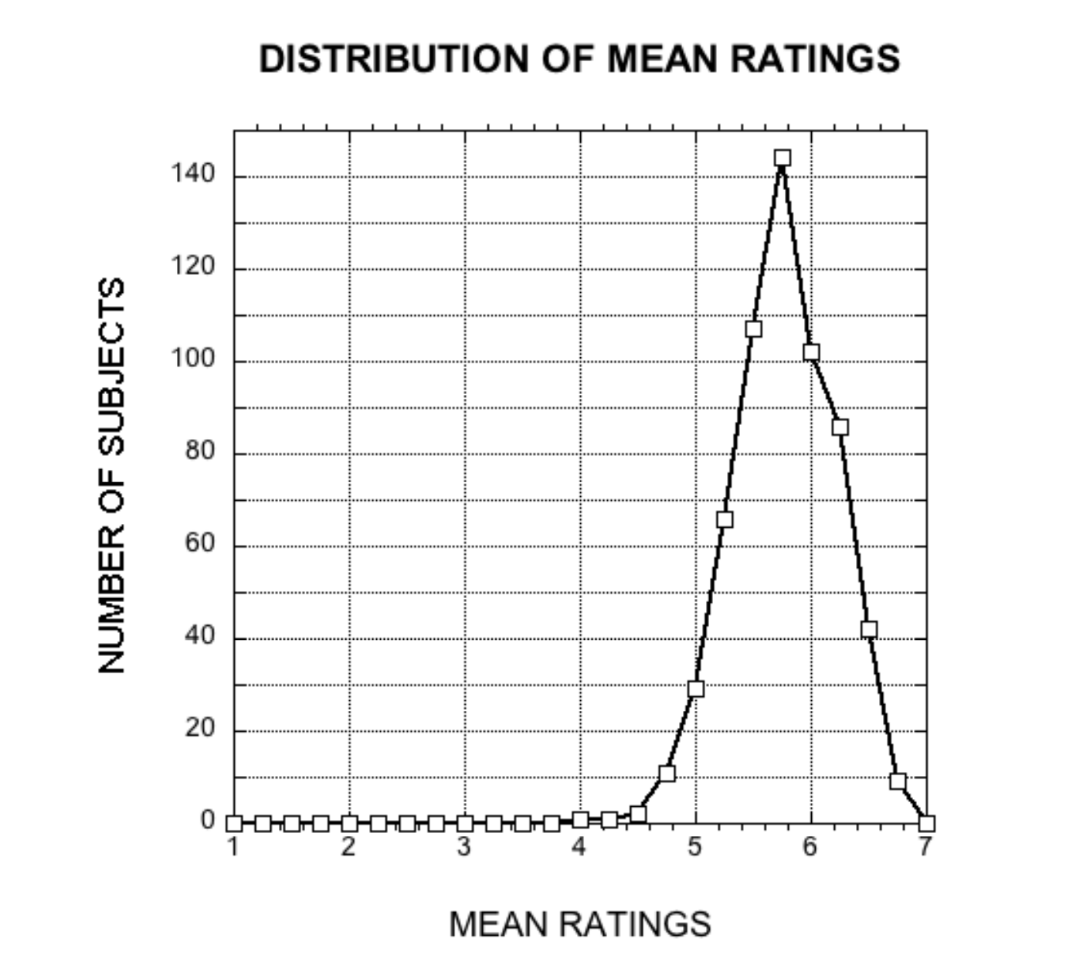
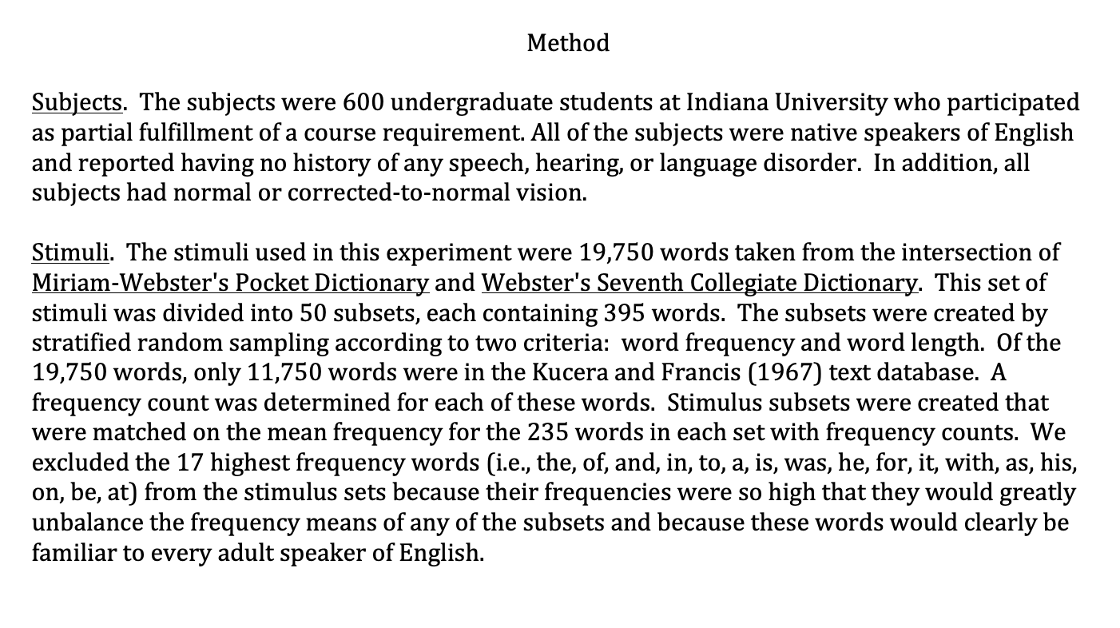
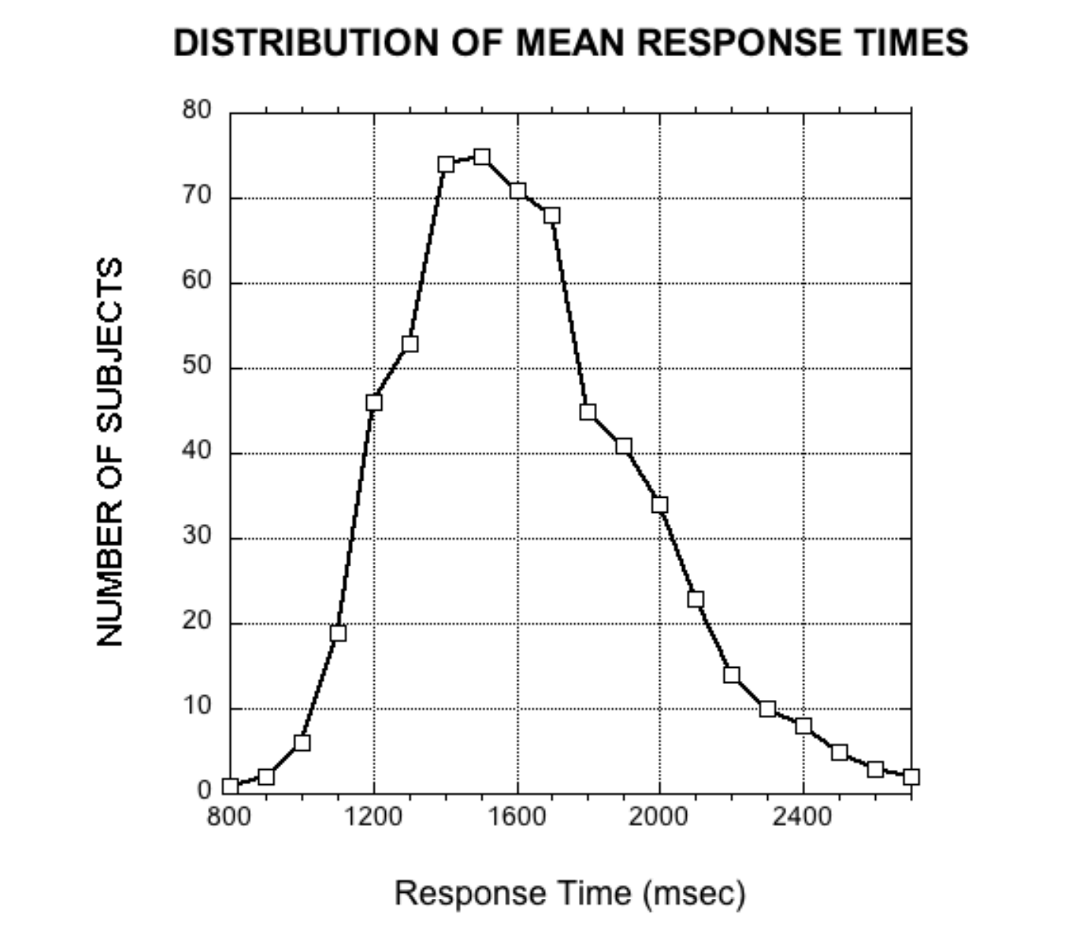
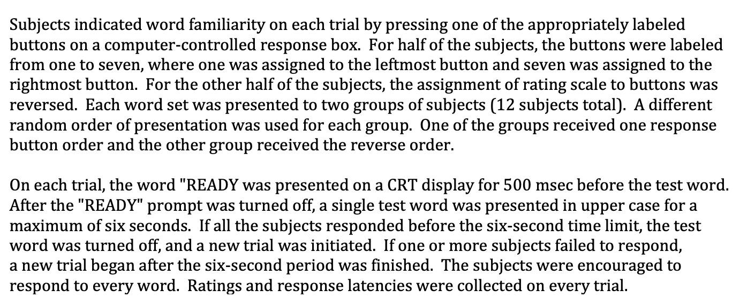
Background
Processing
Norms
Conclusions
Megastudies

Slide 12
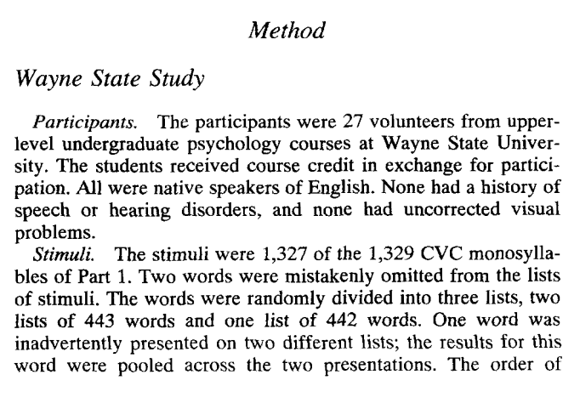
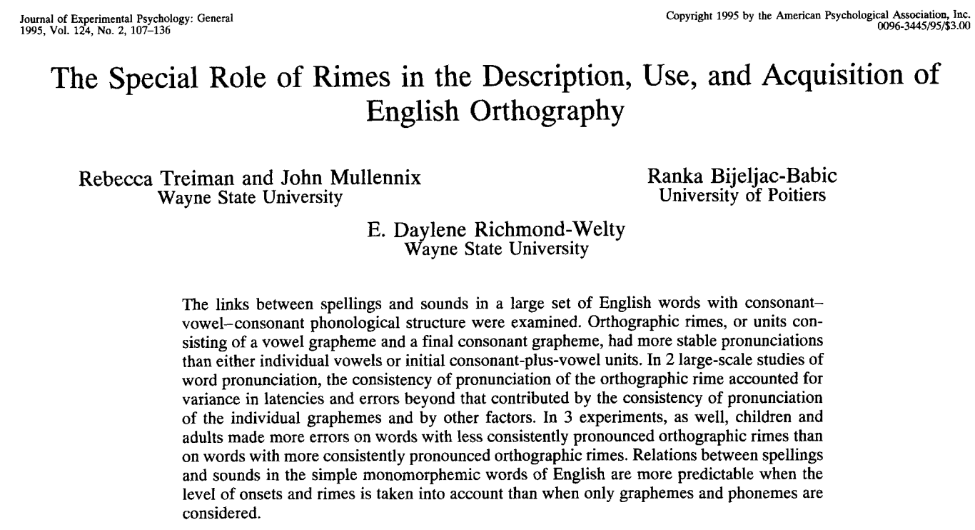
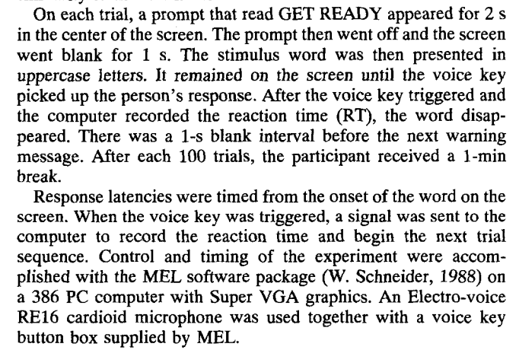
Background
Processing
Norms
Conclusions
Megastudies

Slide 13
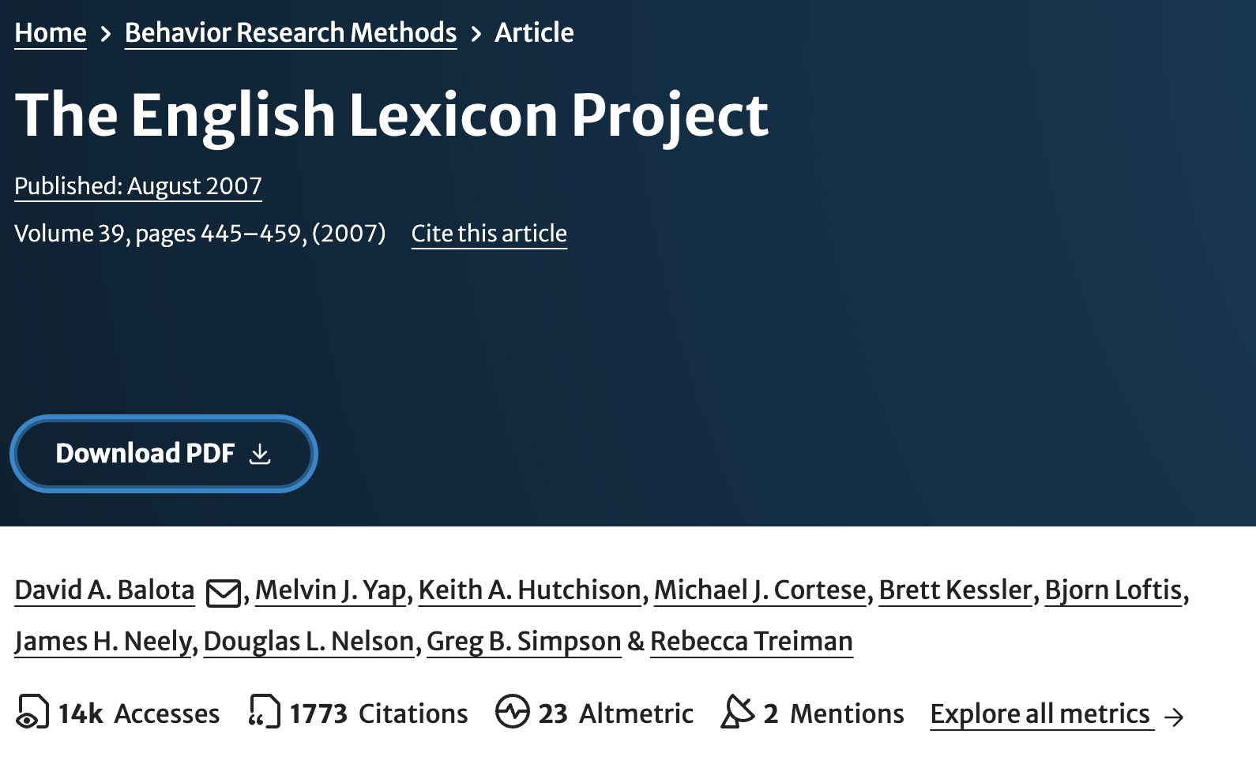
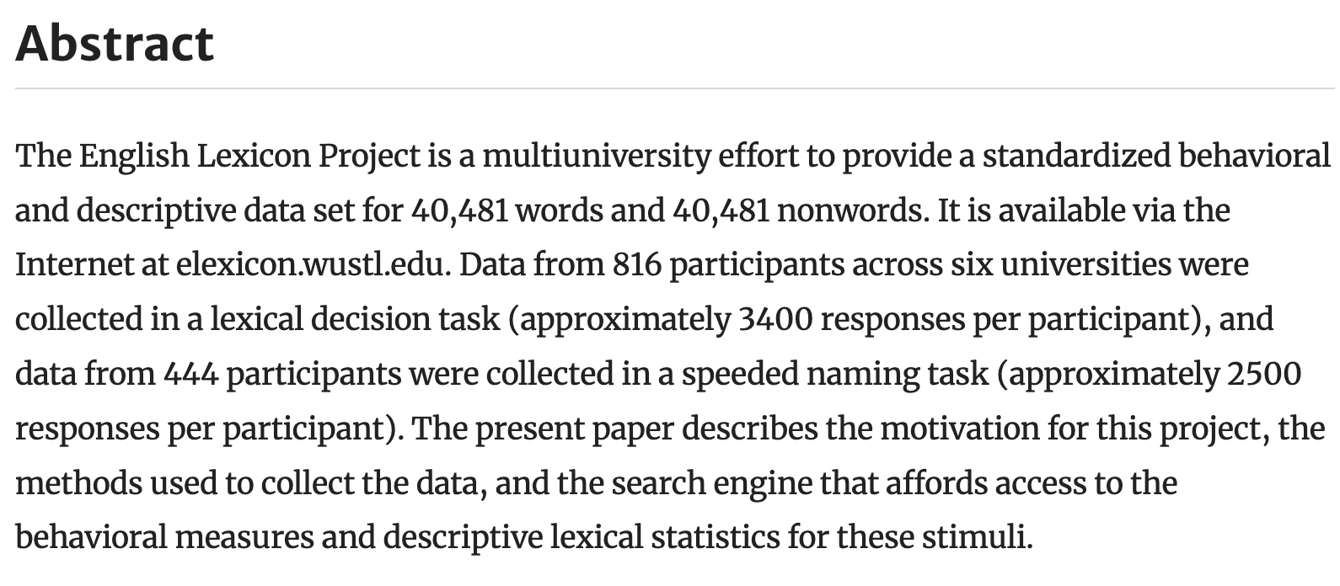
Background
Processing
Norms
Conclusions
Megastudies
https://elexicon.wustl.edu/wordstart.html

Slide 14

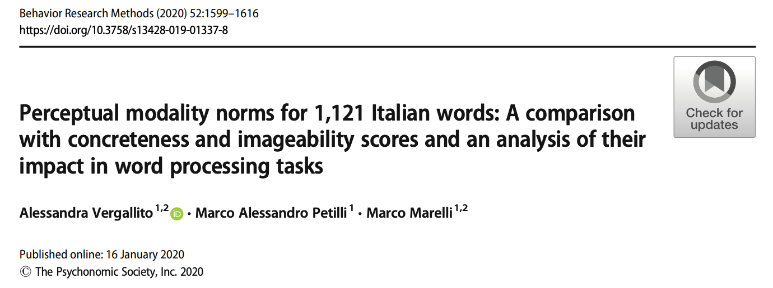
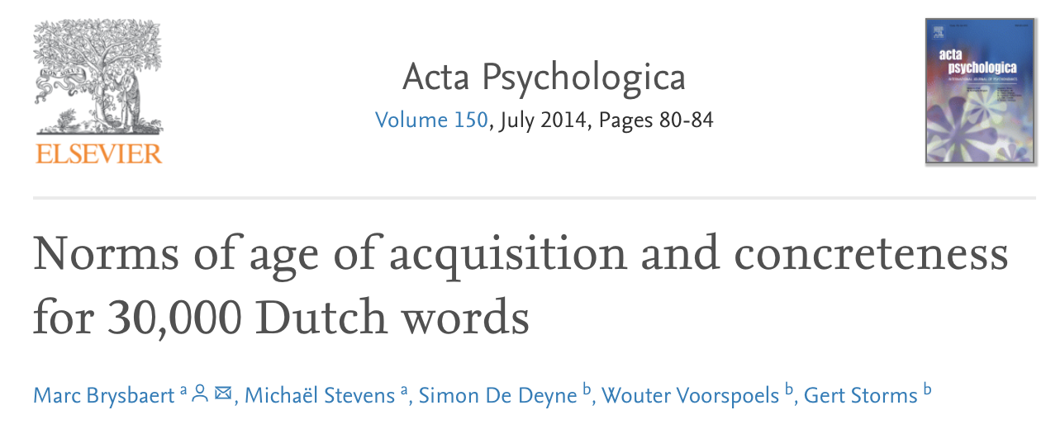
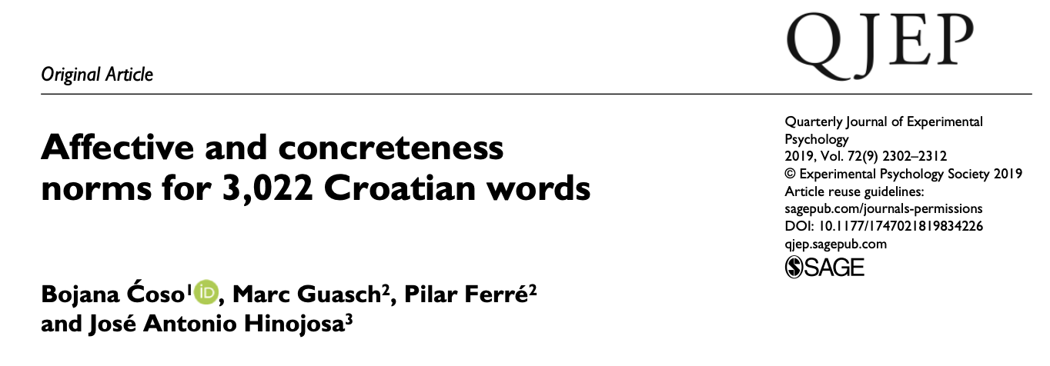
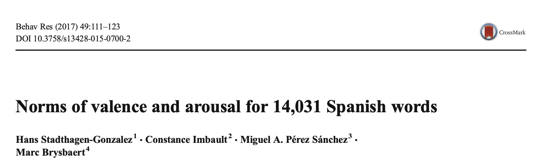
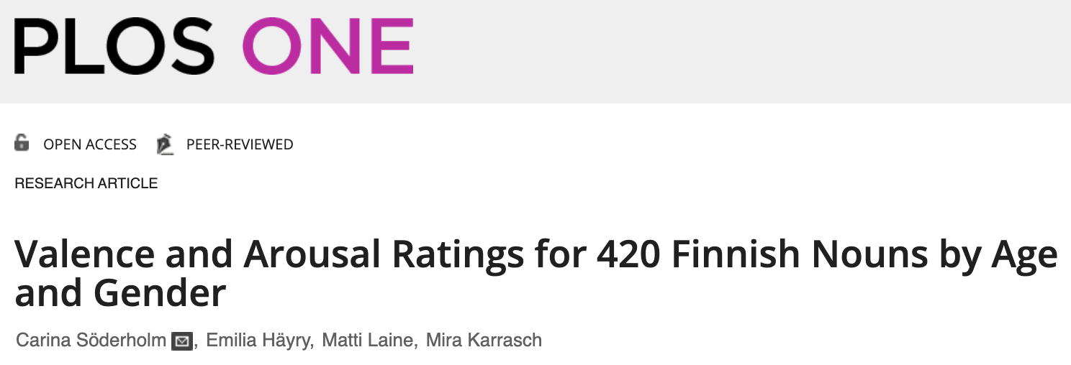
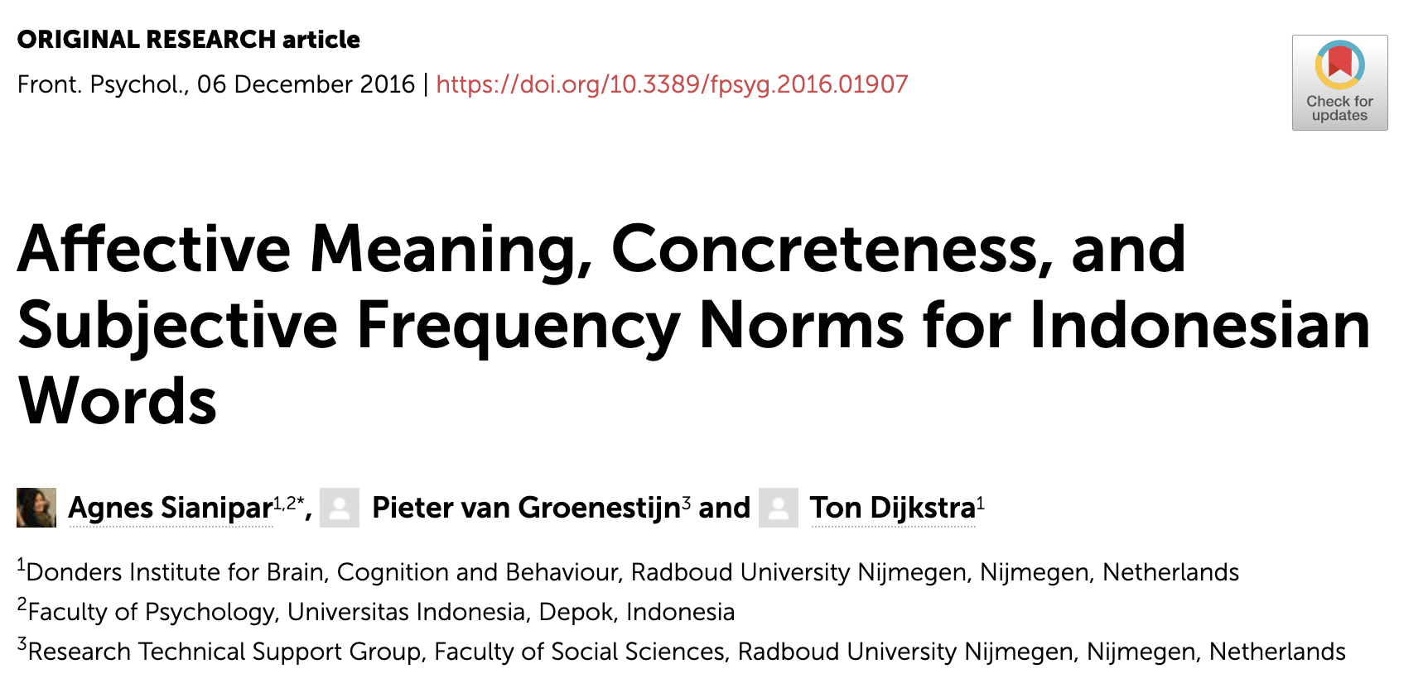
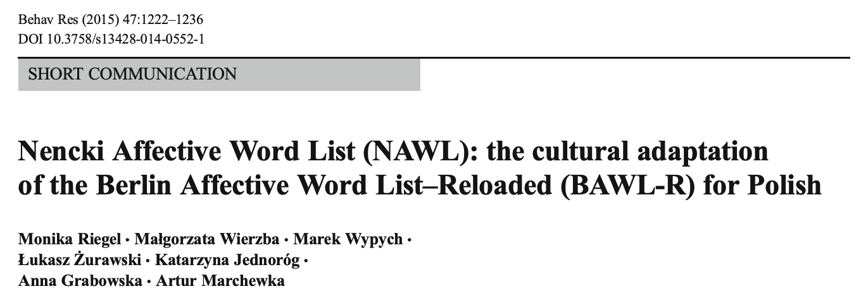
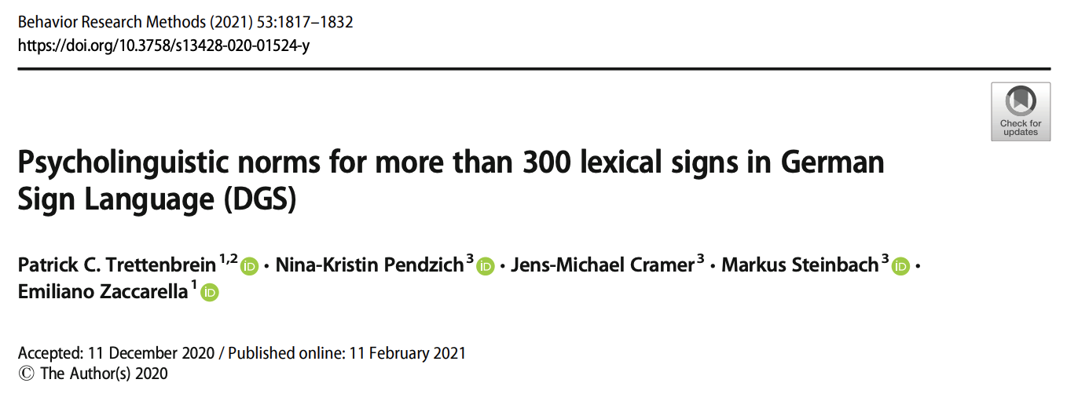
Background
Processing
Norms
Conclusions
Megastudies

Slide 15
Background
Processing
Norms
Conclusions
Crowdsourcing participants

Slide 16
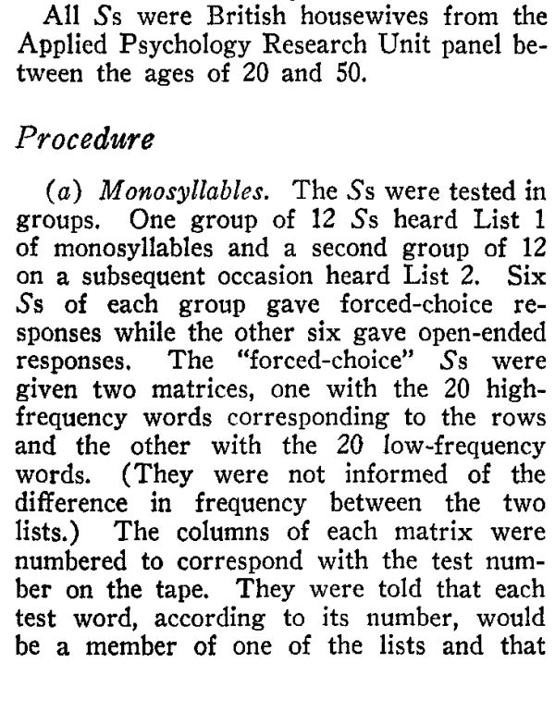
Background
Processing
Norms
Conclusions
Traditional studies

Slide 17
Background
Processing
Norms
Conclusions
Crowdsourcing
item1, item2, … item_{n} n = thousands

Slide 18
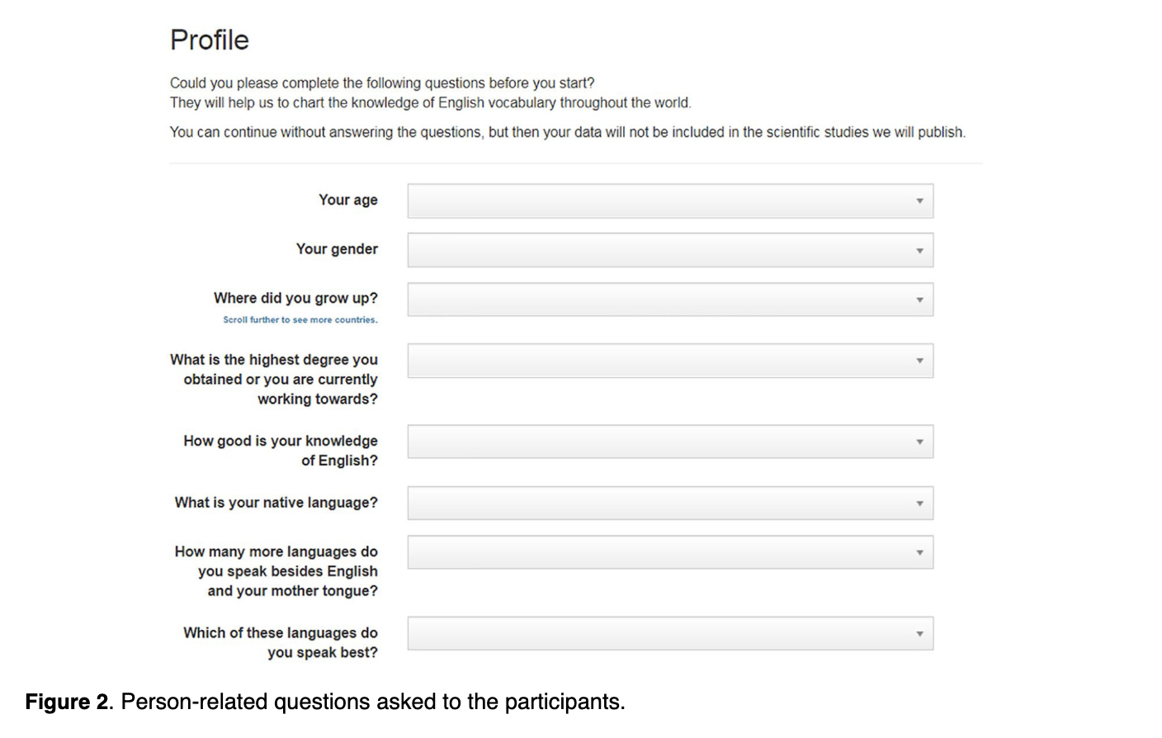
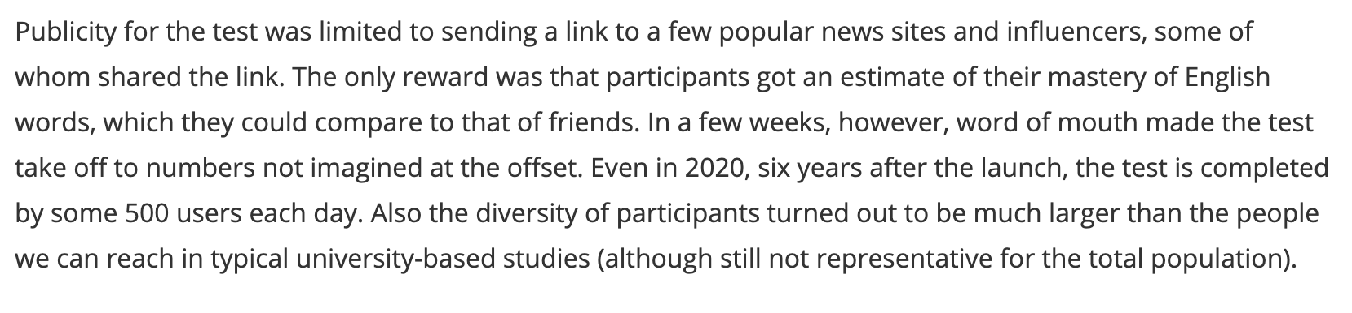
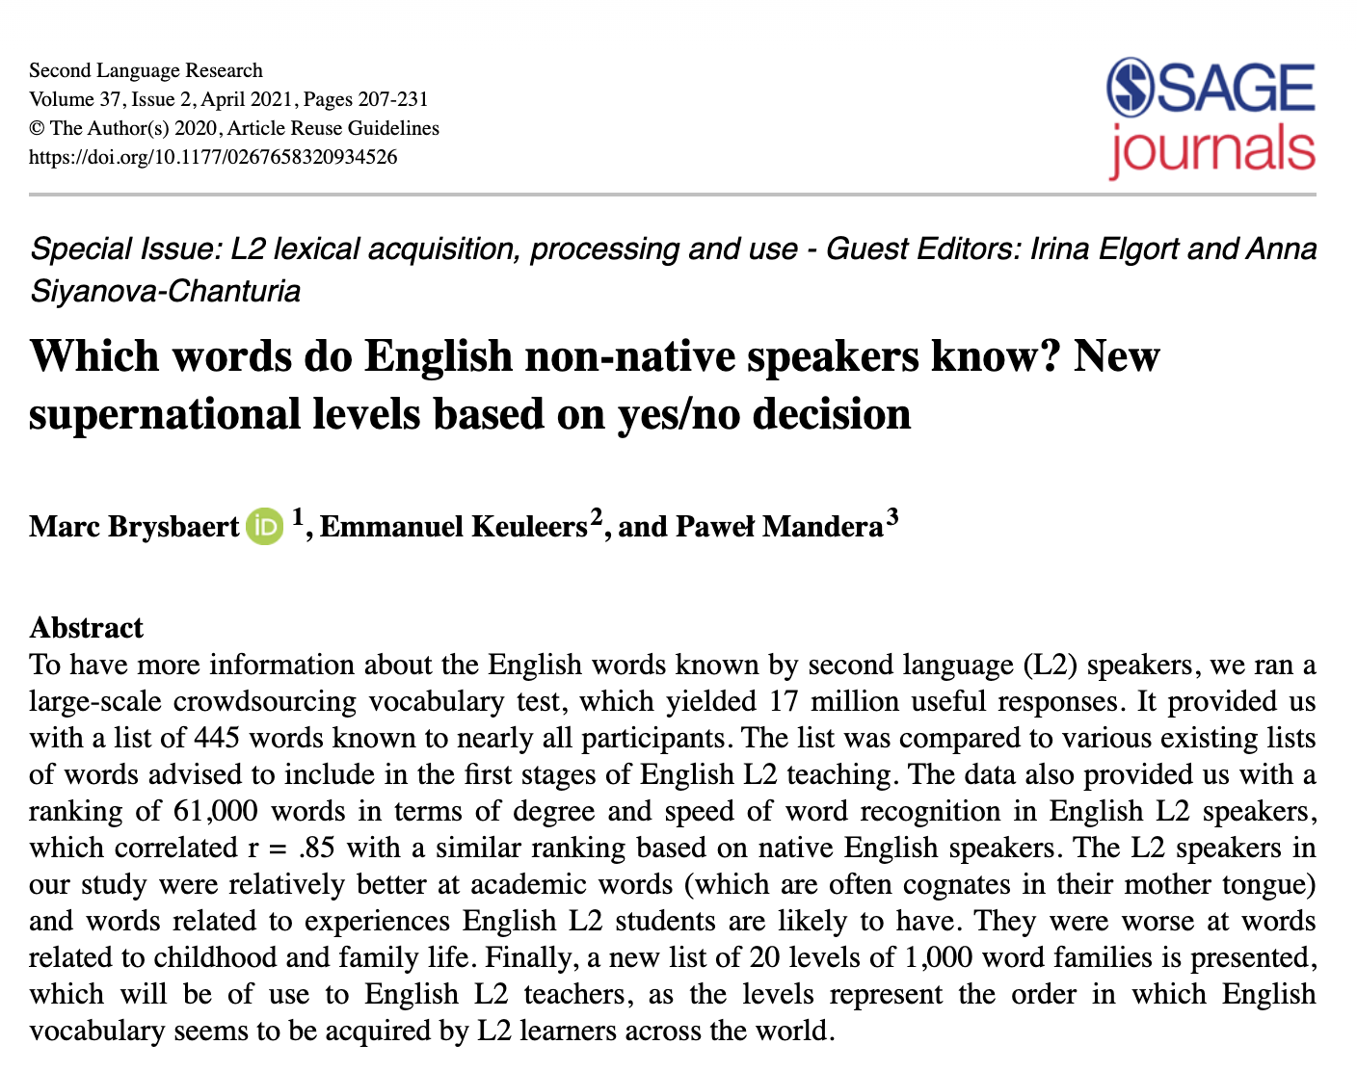
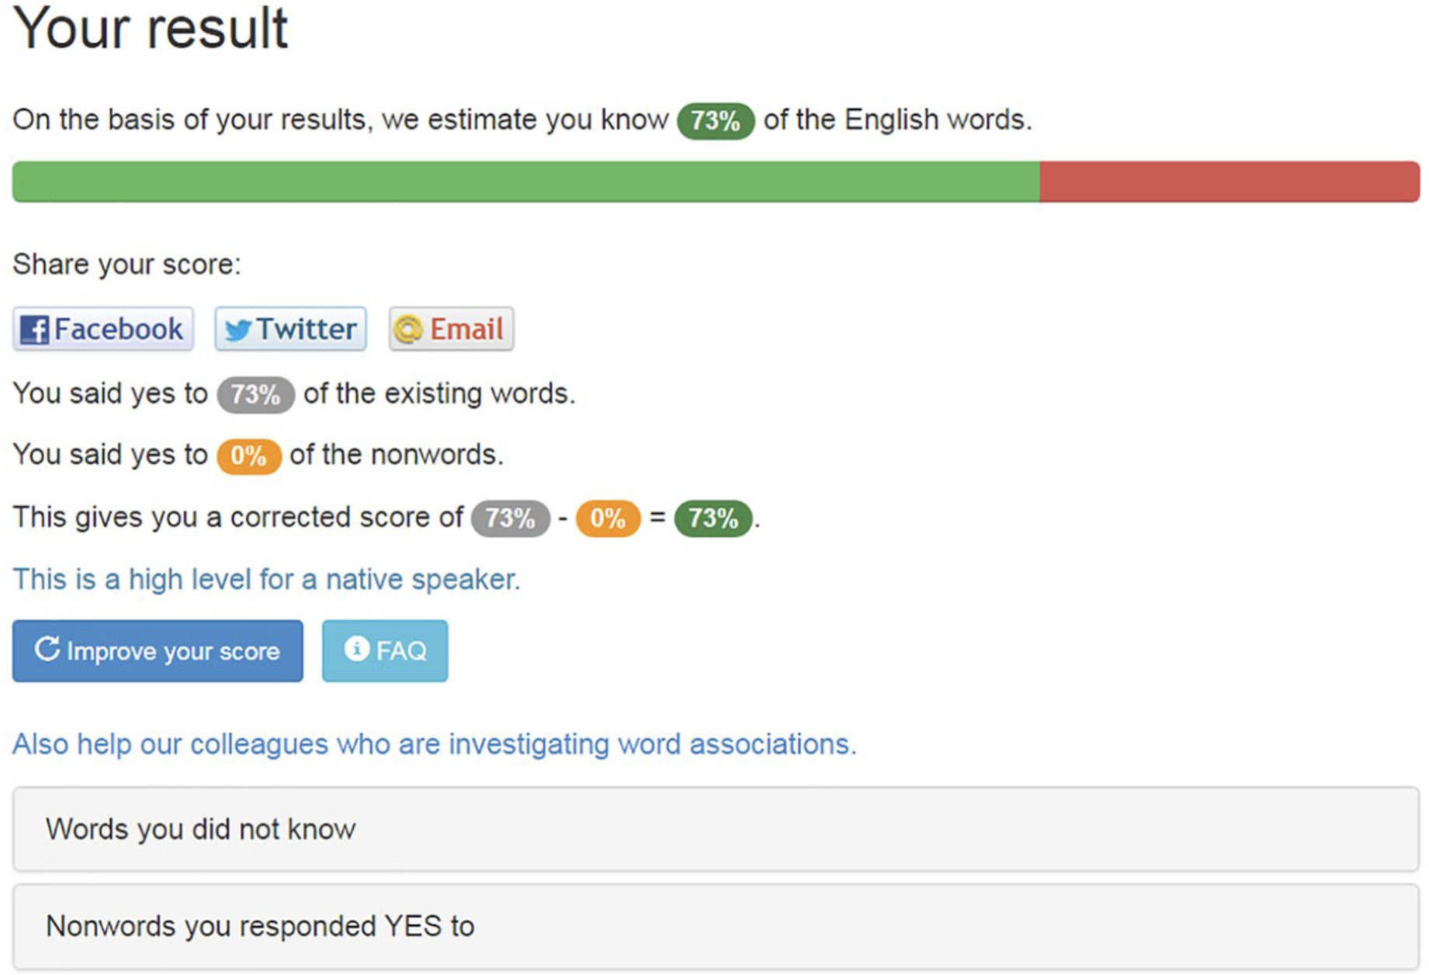
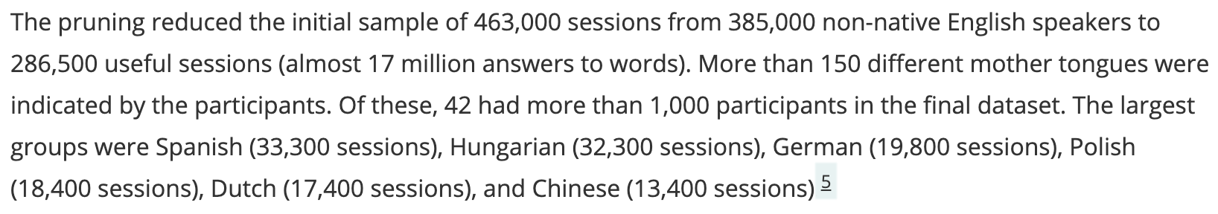
Background
Processing
Norms
Conclusions
Crowdsourcing

Slide 19
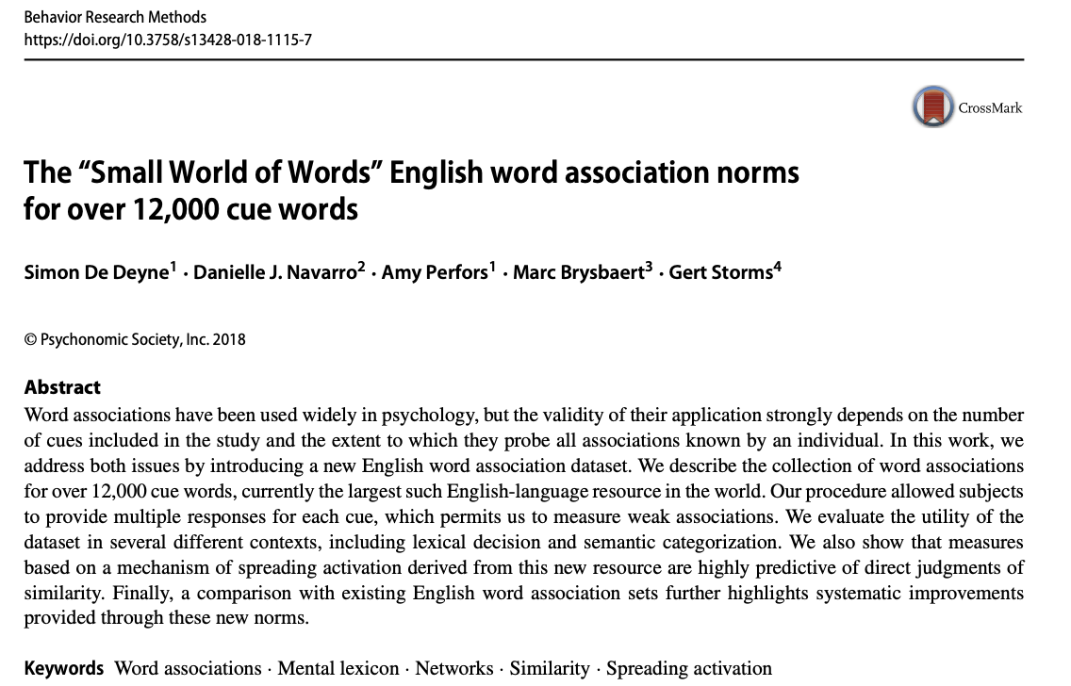
Background
Processing
Norms
Conclusions
Crowdsourcing
https://smallworldofwords.org

Slide 20
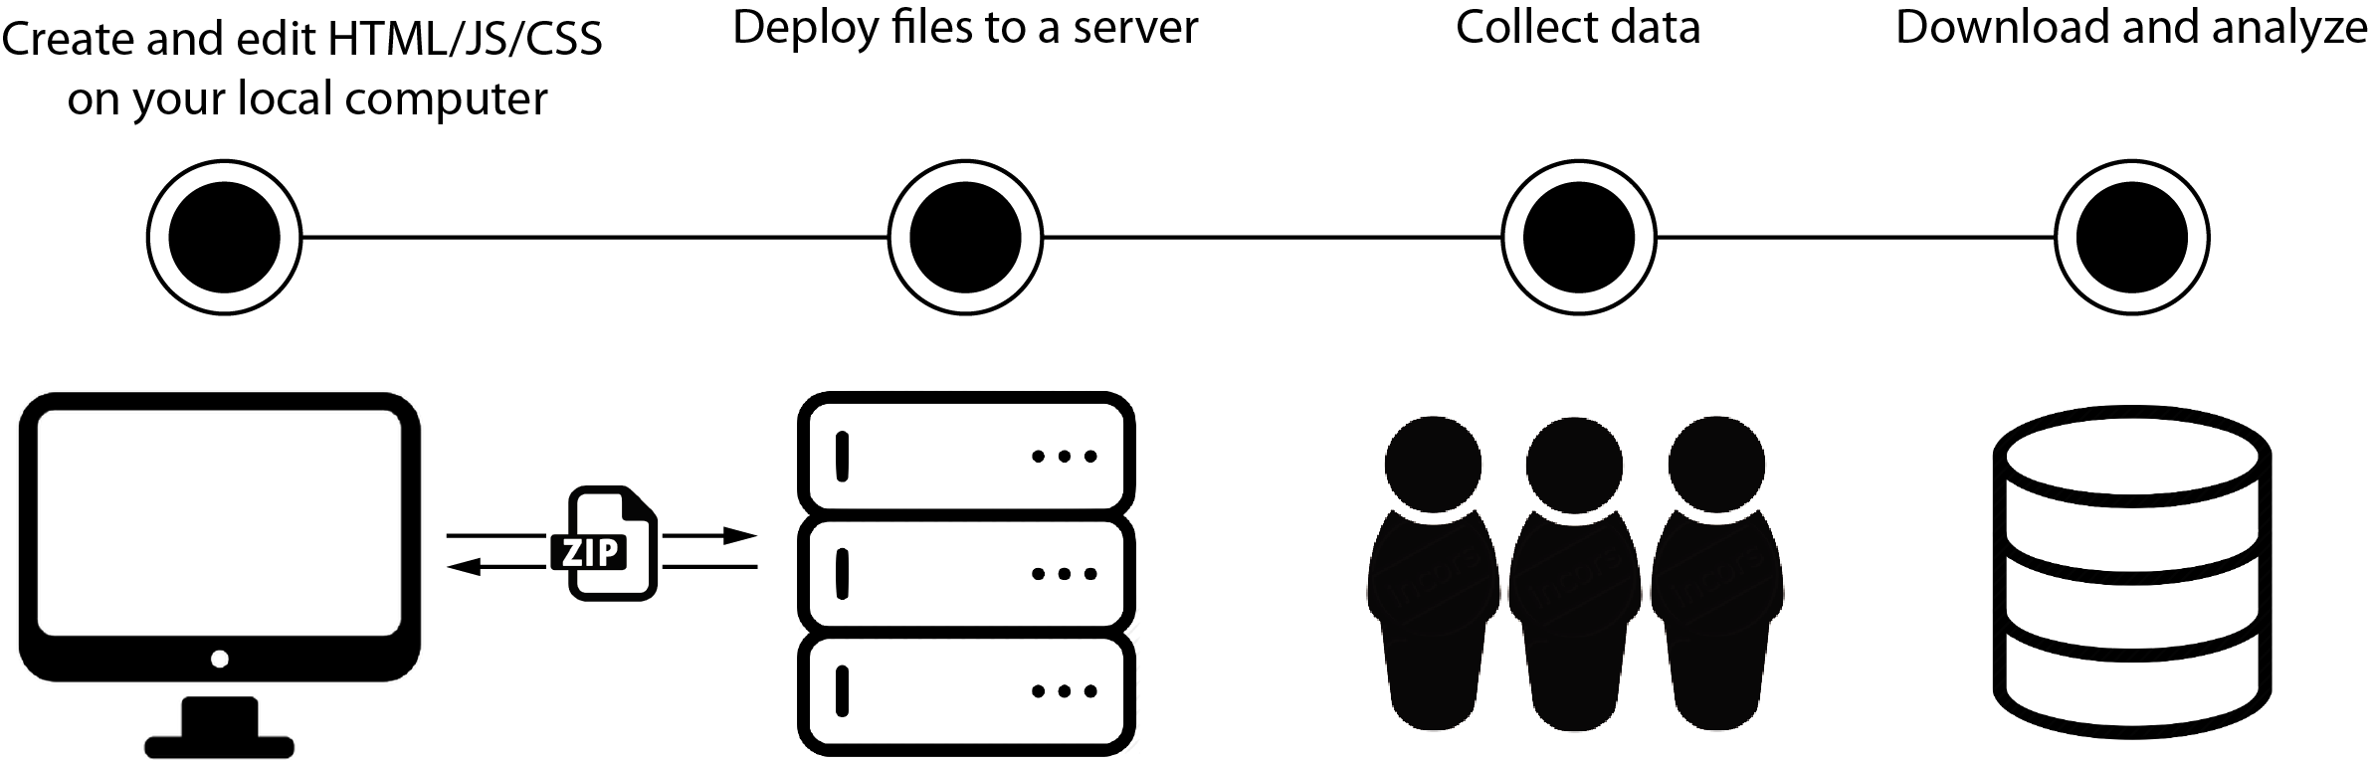




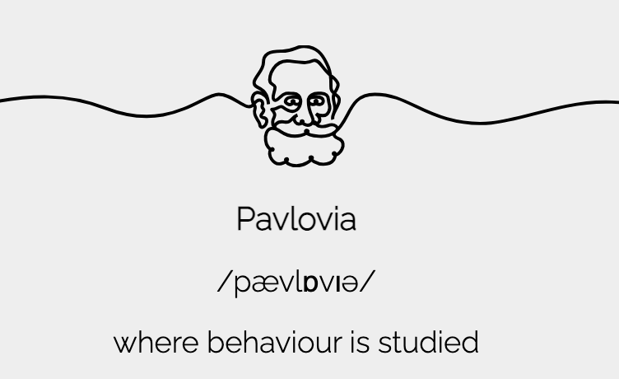


Background
Processing
Norms
Conclusions
Crowdsourcing
https://www.jatos.org/Example-Studies

Slide 21
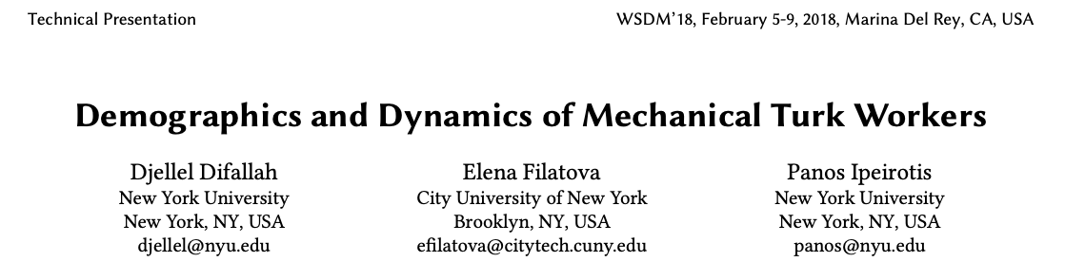


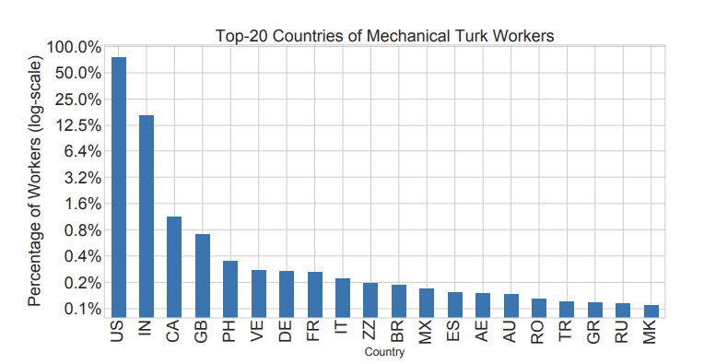
Background
Processing
Norms
Conclusions
Crowdsourcing

Slide 22
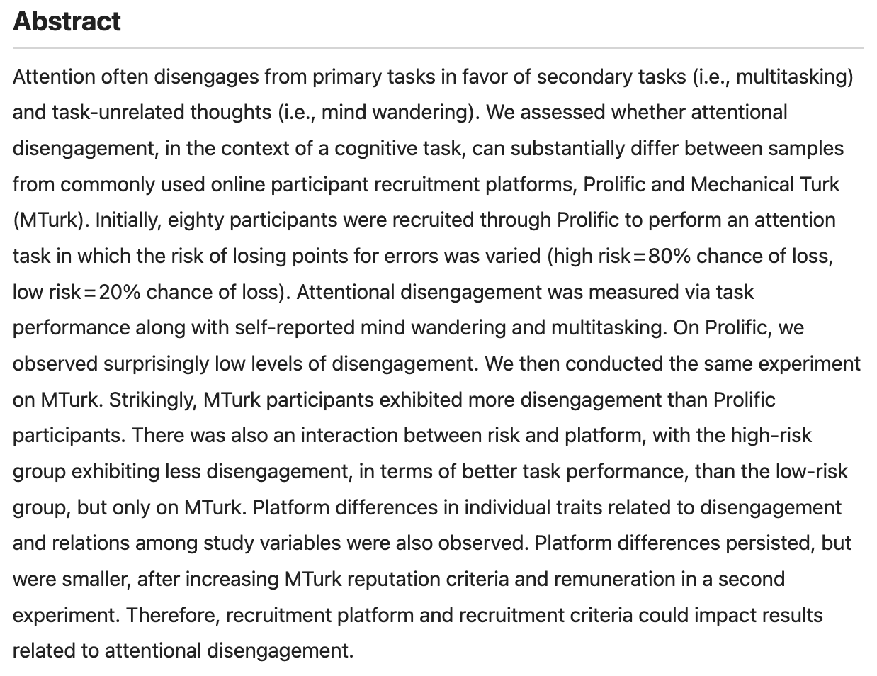
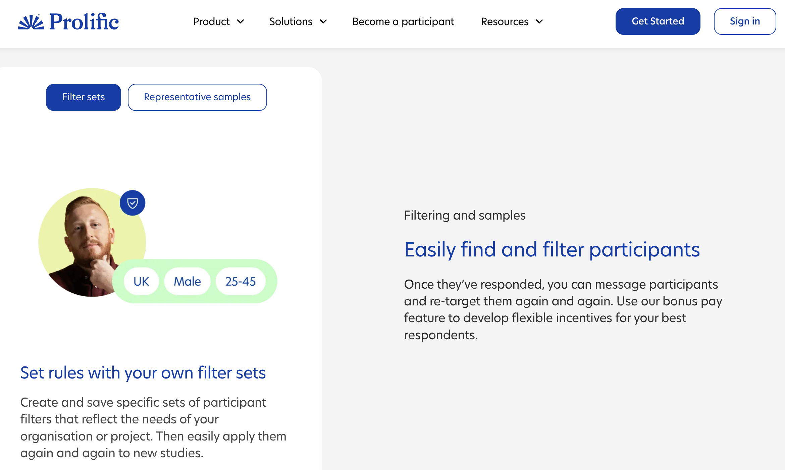
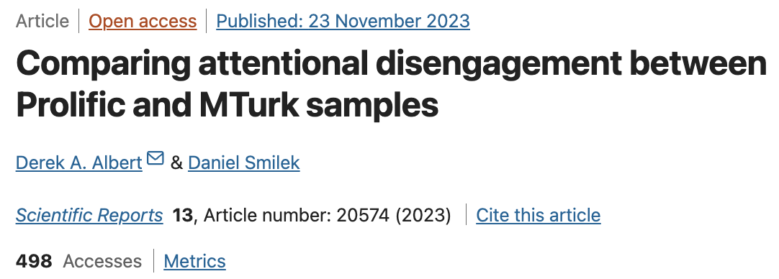

Background
Processing
Norms
Conclusions
Crowdsourcing

Slide 23
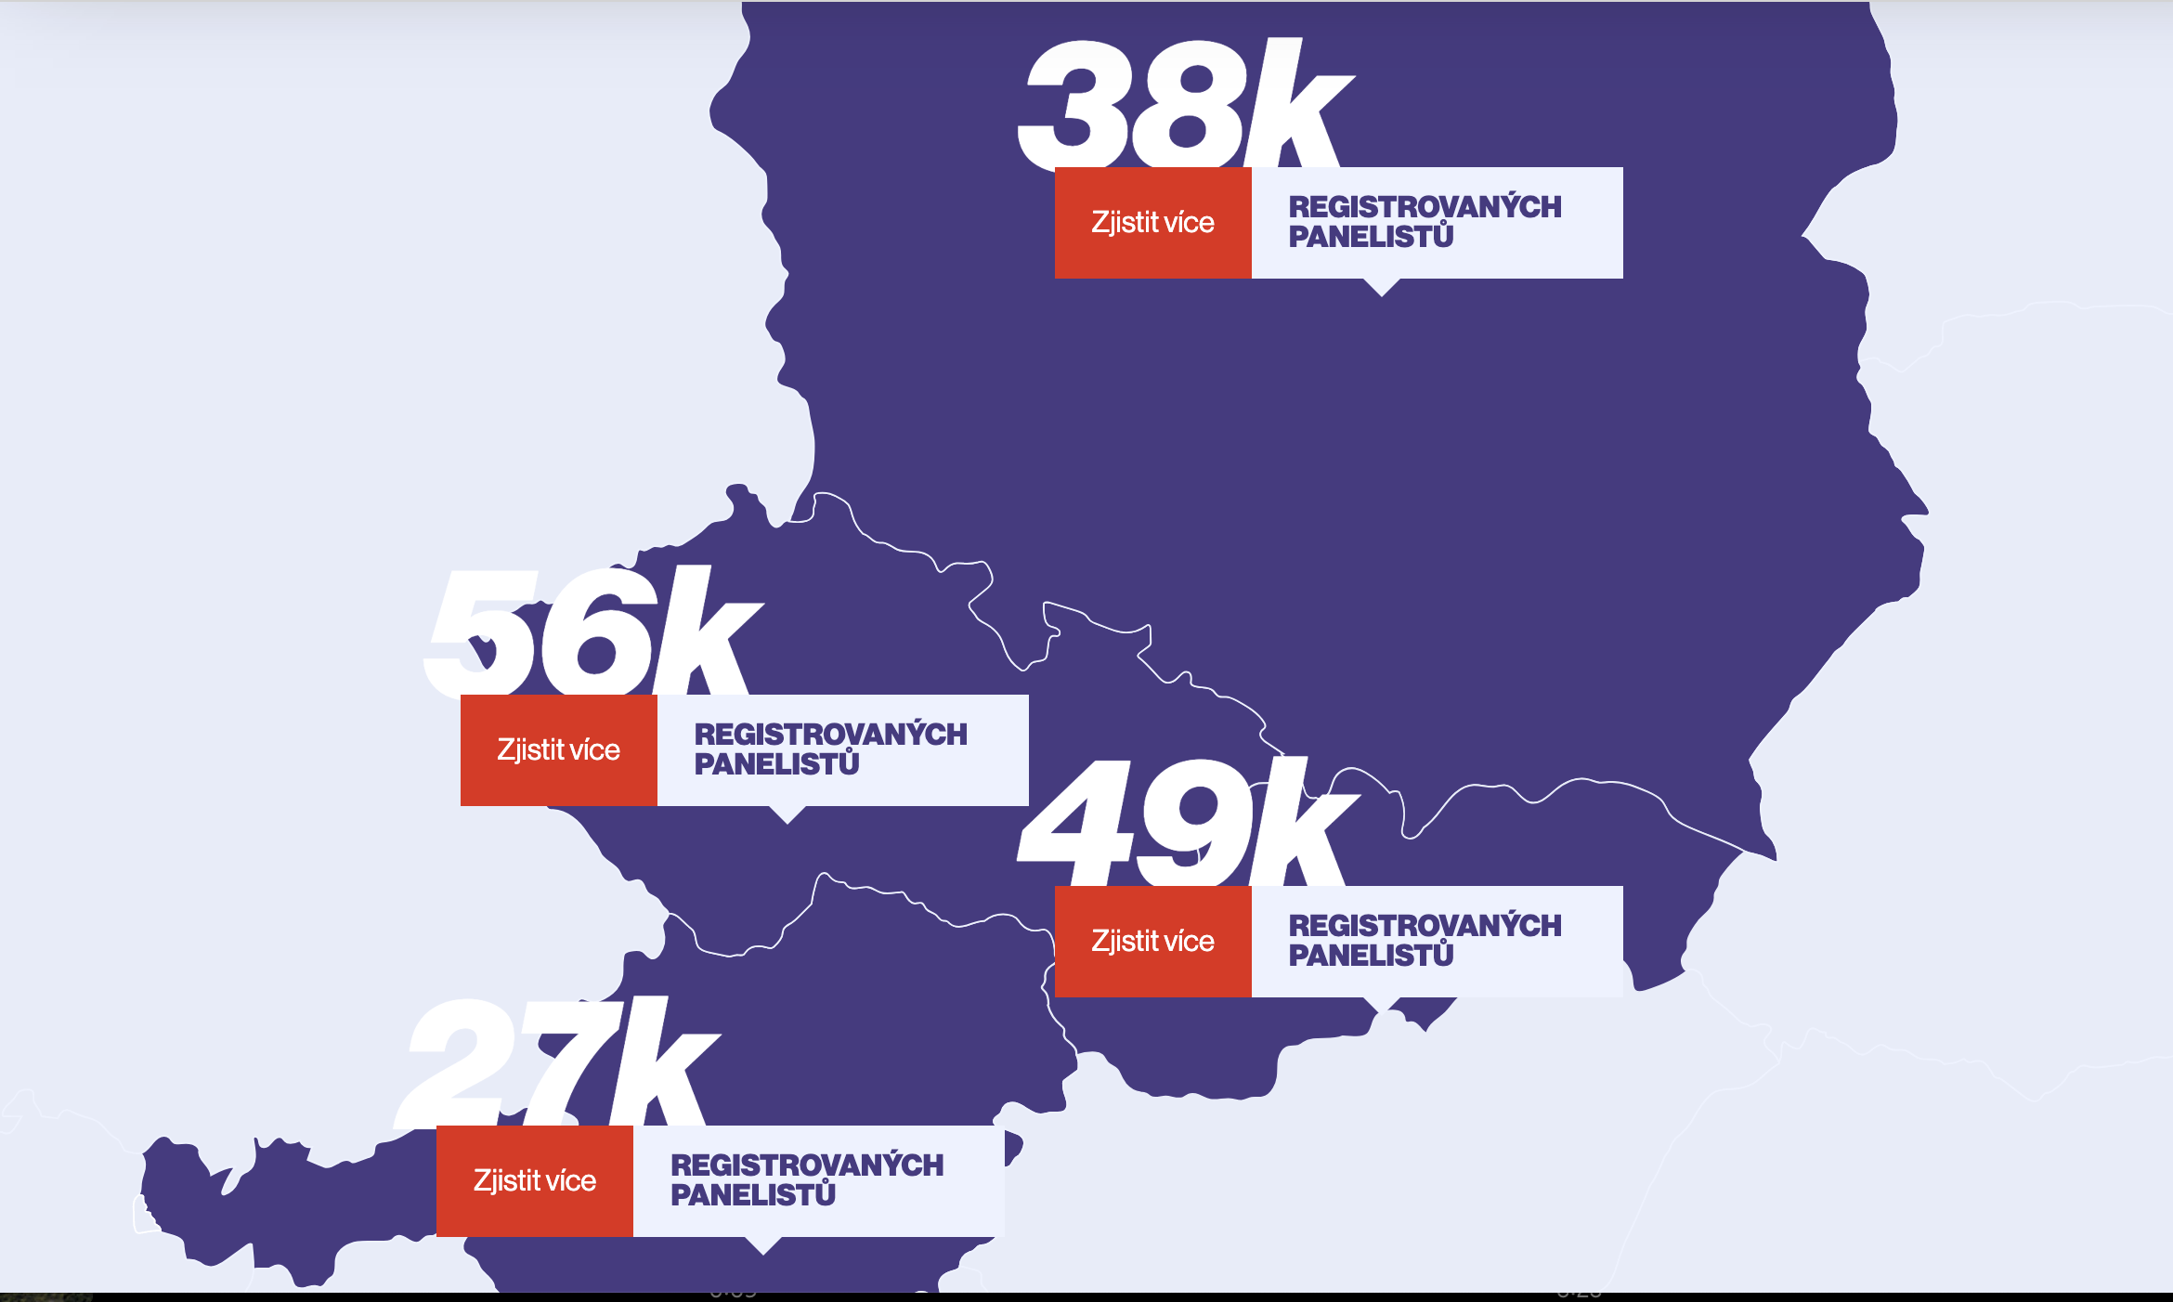

Background
Processing
Norms
Conclusions
Crowdsourcing

Slide 24
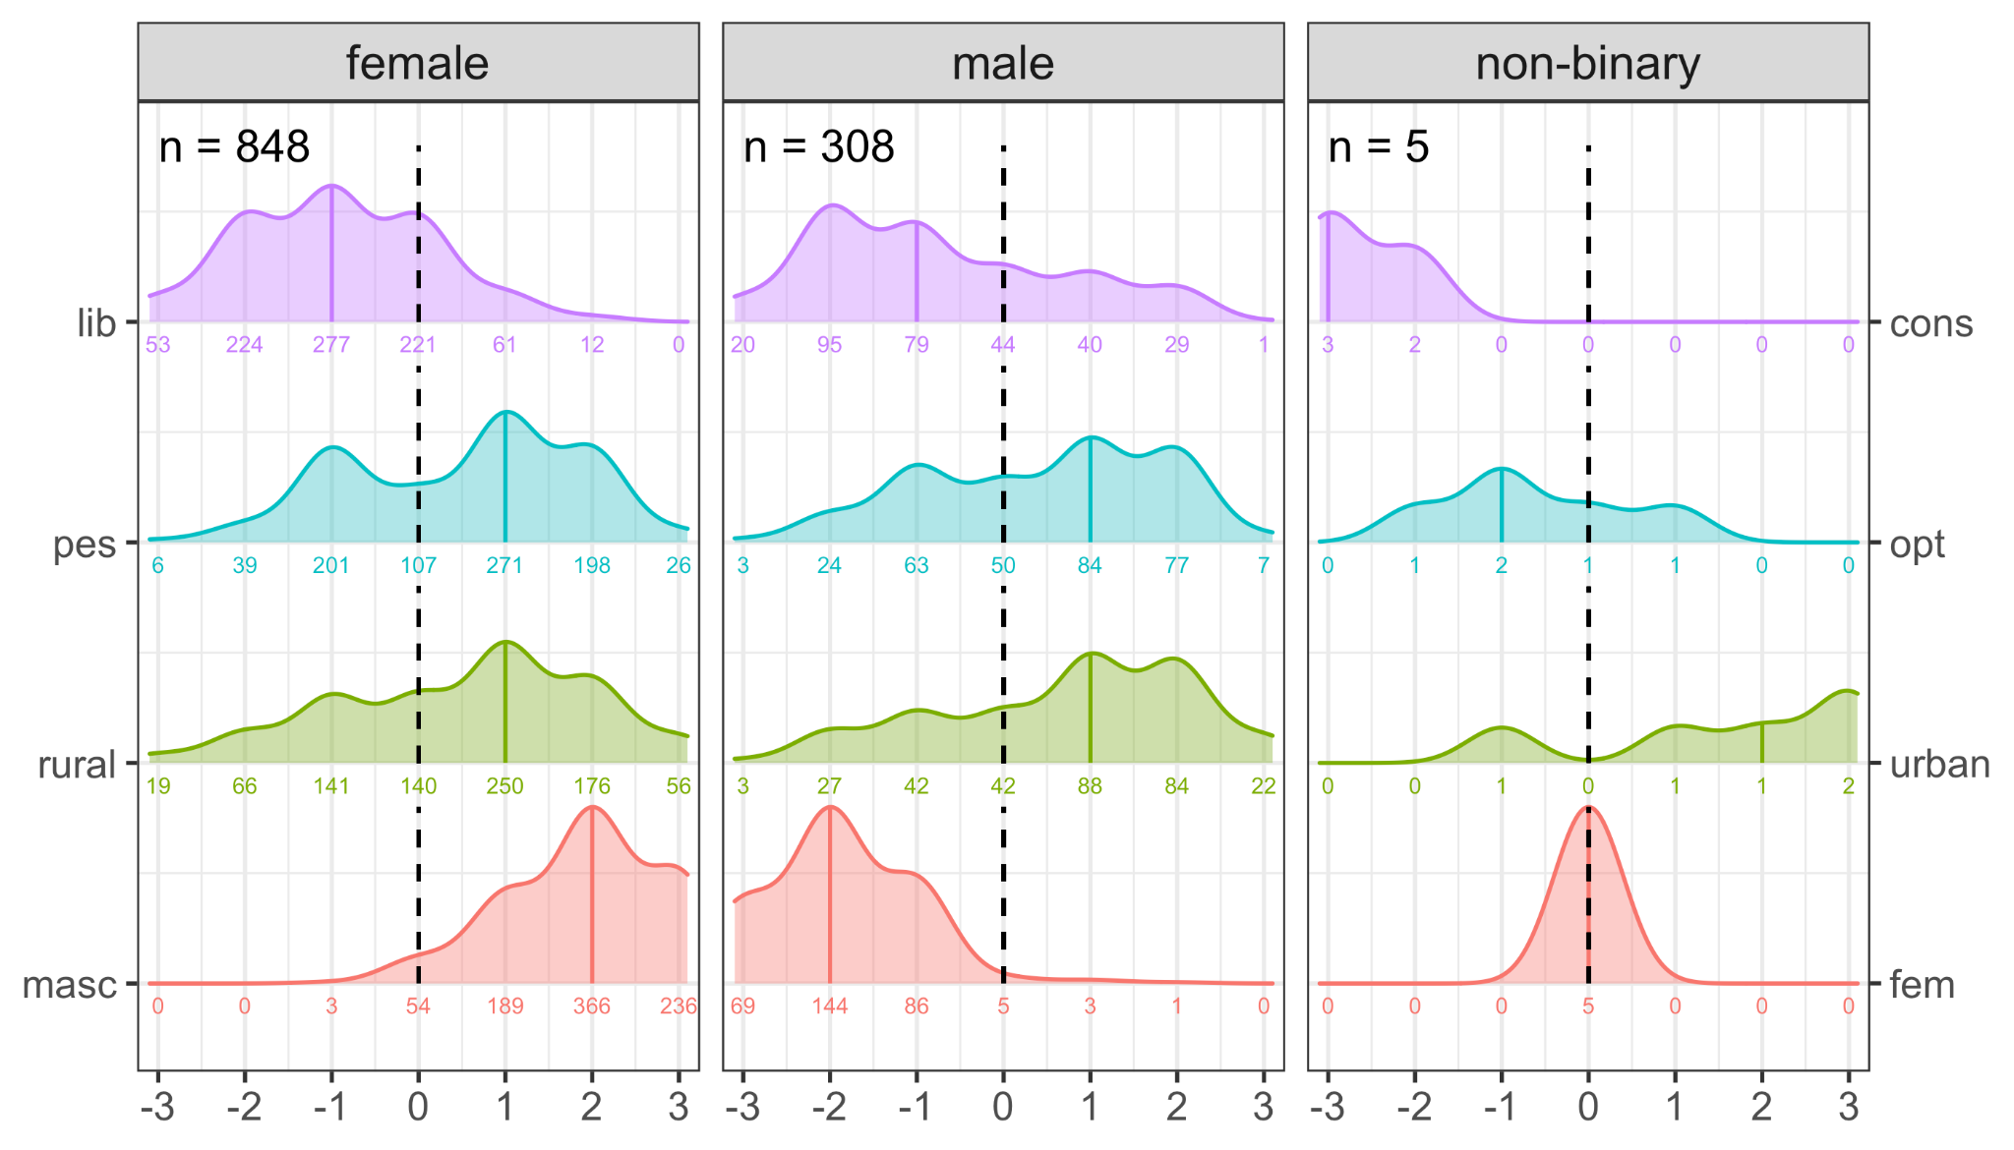

Background
Processing
Norms
Conclusions
Crowdsourcing

Slide 25
Background
Processing
Norms
Conclusions
Crowdsourcing
Pros
- Fast data collection
- Participation anytime and anywhere
- Diverse participant pool
- Larger sample sizes
- Multiple experiments can be run
Cons
- Stricter data quality checks
- Participation anytime and anywhere
- Experimental design is adapted
- Cost
- Needs expertise for online research

Slide 26
Background
Processing
Norms
Conclusions
Crowdsourcing science

Slide 27
Background
Processing
Norms
Conclusions
Traditional studies
item1, item2, … item_{n} n = >10 and <100

Slide 28
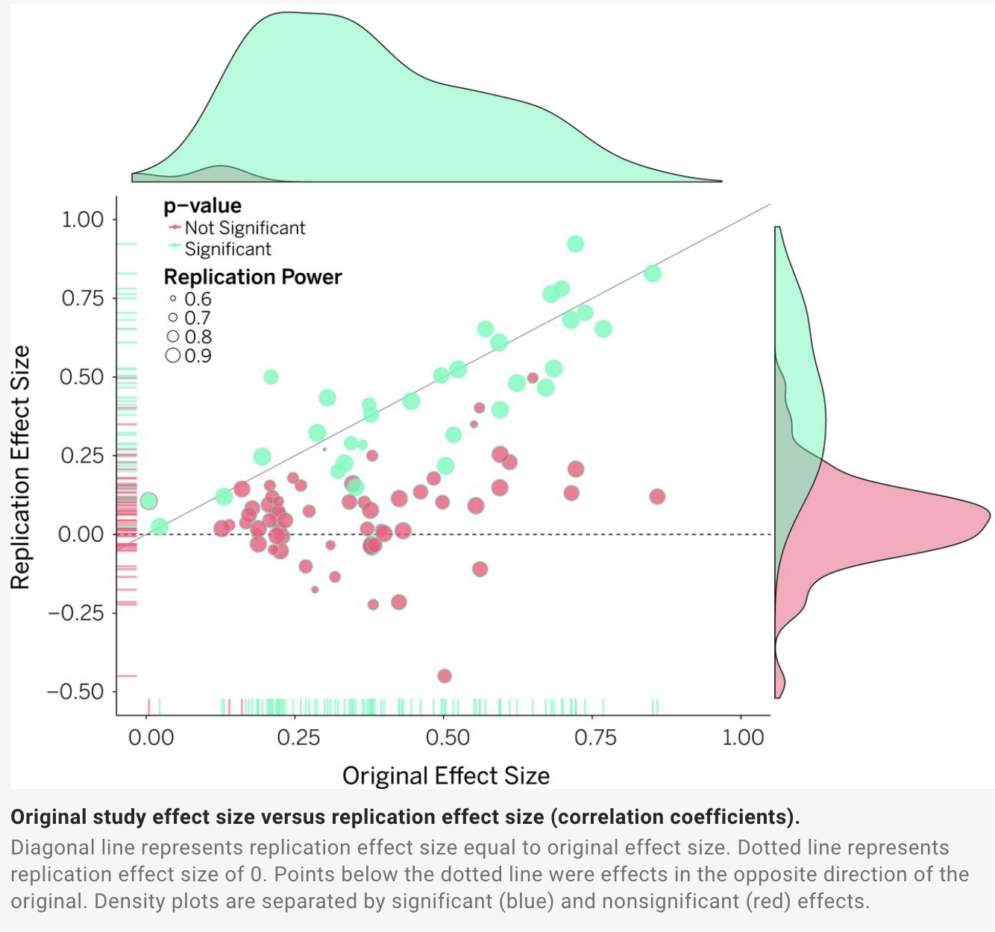

Background
Processing
Norms
Conclusions
Traditional studies

Slide 29
Background
Processing
Norms
Conclusions
Crowdsourcing
item1, item2, … item_{n} n = >10 and <100

Slide 30

Background
Processing
Norms
Conclusions
Crowdsourcing

Slide 31

Background
Processing
Norms
Conclusions
Crowdsourcing

Slide 32

Background
Processing
Norms
Conclusions
Crowdsourcing

Slide 33

Background
Processing
Norms
Conclusions
Crowdsourcing

Slide 34

Background
Processing
Norms
Conclusions
Crowdsourcing

Slide 35

Background
Processing
Norms
Conclusions
Crowdsourcing

Slide 36
Background
Processing
Norms
Conclusions
Language processing in Czech

Slide 37
Background
Processing
Norms
Conclusions
Self-paced reading
The physics students were waiting outside. Rebecca was cold.
The physics students were waiting outside. Rebecca was cold.
The physics students were waiting outside. Rebecca was cold.
The physics students were waiting outside. Rebecca was cold.
The physics students were waiting outside. Rebecca was cold.
The physics students were waiting outside. Rebecca was cold.
The physics students were waiting outside. Rebecca was cold.
The physics students were waiting outside. Rebecca was cold.
The physics students were waiting outside. Rebecca was cold.
___ _______ ________ ____ _______ ________ _______ ___ _____
Notes:
The question whether grammatical gender has an impact on the way speakers perceive the world around them has been a subject of research for decades.
So far, more than a hundred of experimental studies were published on this topic
These investigations addressed various types of phenomena, most typically whether grammatical gender of the word labels induces gender associations with the object, but also whether speakers generally categorize objects based on the grammatical gender of their labels
And what was shown is that the results generally highly depend on the task that was chosen
Namely, linguistic relativity effects were mostly found in studies where gender was a salient part of the task, in experiments where animate rather than inanimate targets where used, in cases when the target language had two rather than three grammatical genders, and lastly in tasks where gender was addressed explicitly, such as sex assignment and voice choice
However, to assess whether grammatical gender influences speakers perception on a subconscious level, we would need experiments that employ more implicit paradigms

Slide 38
Background
Processing
Norms
Conclusions
Self-paced reading
Was Rebecca sitting outside?
Yes No Don’t know
Notes:
The question whether grammatical gender has an impact on the way speakers perceive the world around them has been a subject of research for decades.
So far, more than a hundred of experimental studies were published on this topic
These investigations addressed various types of phenomena, most typically whether grammatical gender of the word labels induces gender associations with the object, but also whether speakers generally categorize objects based on the grammatical gender of their labels
And what was shown is that the results generally highly depend on the task that was chosen
Namely, linguistic relativity effects were mostly found in studies where gender was a salient part of the task, in experiments where animate rather than inanimate targets where used, in cases when the target language had two rather than three grammatical genders, and lastly in tasks where gender was addressed explicitly, such as sex assignment and voice choice
However, to assess whether grammatical gender influences speakers perception on a subconscious level, we would need experiments that employ more implicit paradigms

Slide 39


Background
Processing
Norms
Conclusions
Self-paced reading
HeCz: A large scale self-paced reading corpus of newspaper headlines
Notes:
The question whether grammatical gender has an impact on the way speakers perceive the world around them has been a subject of research for decades.
So far, more than a hundred of experimental studies were published on this topic
These investigations addressed various types of phenomena, most typically whether grammatical gender of the word labels induces gender associations with the object, but also whether speakers generally categorize objects based on the grammatical gender of their labels
And what was shown is that the results generally highly depend on the task that was chosen
Namely, linguistic relativity effects were mostly found in studies where gender was a salient part of the task, in experiments where animate rather than inanimate targets where used, in cases when the target language had two rather than three grammatical genders, and lastly in tasks where gender was addressed explicitly, such as sex assignment and voice choice
However, to assess whether grammatical gender influences speakers perception on a subconscious level, we would need experiments that employ more implicit paradigms

Slide 40

Background
Processing
Norms
Conclusions
Self-paced reading
Notes:
The question whether grammatical gender has an impact on the way speakers perceive the world around them has been a subject of research for decades.
So far, more than a hundred of experimental studies were published on this topic
These investigations addressed various types of phenomena, most typically whether grammatical gender of the word labels induces gender associations with the object, but also whether speakers generally categorize objects based on the grammatical gender of their labels
And what was shown is that the results generally highly depend on the task that was chosen
Namely, linguistic relativity effects were mostly found in studies where gender was a salient part of the task, in experiments where animate rather than inanimate targets where used, in cases when the target language had two rather than three grammatical genders, and lastly in tasks where gender was addressed explicitly, such as sex assignment and voice choice
However, to assess whether grammatical gender influences speakers perception on a subconscious level, we would need experiments that employ more implicit paradigms

Slide 41
Background
Processing
Norms
Conclusions
Self-paced reading
1,919 headlines
23,634 tokens
1,872 native Czech speakers participated
1,162 participants re-tested a month later
All participants completed a mood questionnaire, e.g. how tired/happy/anxious they were before reading
Lemmatization and PoS tagging using MorphoDiTa
Notes:
The question whether grammatical gender has an impact on the way speakers perceive the world around them has been a subject of research for decades.
So far, more than a hundred of experimental studies were published on this topic
These investigations addressed various types of phenomena, most typically whether grammatical gender of the word labels induces gender associations with the object, but also whether speakers generally categorize objects based on the grammatical gender of their labels
And what was shown is that the results generally highly depend on the task that was chosen
Namely, linguistic relativity effects were mostly found in studies where gender was a salient part of the task, in experiments where animate rather than inanimate targets where used, in cases when the target language had two rather than three grammatical genders, and lastly in tasks where gender was addressed explicitly, such as sex assignment and voice choice
However, to assess whether grammatical gender influences speakers perception on a subconscious level, we would need experiments that employ more implicit paradigms

Slide 42
Background
Processing
Norms
Conclusions
Self-paced reading
http://tinyurl.com/spr-kogntivni
Notes:
The question whether grammatical gender has an impact on the way speakers perceive the world around them has been a subject of research for decades.
So far, more than a hundred of experimental studies were published on this topic
These investigations addressed various types of phenomena, most typically whether grammatical gender of the word labels induces gender associations with the object, but also whether speakers generally categorize objects based on the grammatical gender of their labels
And what was shown is that the results generally highly depend on the task that was chosen
Namely, linguistic relativity effects were mostly found in studies where gender was a salient part of the task, in experiments where animate rather than inanimate targets where used, in cases when the target language had two rather than three grammatical genders, and lastly in tasks where gender was addressed explicitly, such as sex assignment and voice choice
However, to assess whether grammatical gender influences speakers perception on a subconscious level, we would need experiments that employ more implicit paradigms

Slide 43

Background
Processing
Norms
Conclusions
Self-paced reading
Nearly 5 million observations
RTs to each word in ms
Comprehension question accuracy
Notes:
The question whether grammatical gender has an impact on the way speakers perceive the world around them has been a subject of research for decades.
So far, more than a hundred of experimental studies were published on this topic
These investigations addressed various types of phenomena, most typically whether grammatical gender of the word labels induces gender associations with the object, but also whether speakers generally categorize objects based on the grammatical gender of their labels
And what was shown is that the results generally highly depend on the task that was chosen
Namely, linguistic relativity effects were mostly found in studies where gender was a salient part of the task, in experiments where animate rather than inanimate targets where used, in cases when the target language had two rather than three grammatical genders, and lastly in tasks where gender was addressed explicitly, such as sex assignment and voice choice
However, to assess whether grammatical gender influences speakers perception on a subconscious level, we would need experiments that employ more implicit paradigms

Slide 44

Background
Processing
Norms
Conclusions
MouseView-Read
Notes:
The question whether grammatical gender has an impact on the way speakers perceive the world around them has been a subject of research for decades.
So far, more than a hundred of experimental studies were published on this topic
These investigations addressed various types of phenomena, most typically whether grammatical gender of the word labels induces gender associations with the object, but also whether speakers generally categorize objects based on the grammatical gender of their labels
And what was shown is that the results generally highly depend on the task that was chosen
Namely, linguistic relativity effects were mostly found in studies where gender was a salient part of the task, in experiments where animate rather than inanimate targets where used, in cases when the target language had two rather than three grammatical genders, and lastly in tasks where gender was addressed explicitly, such as sex assignment and voice choice
However, to assess whether grammatical gender influences speakers perception on a subconscious level, we would need experiments that employ more implicit paradigms

Slide 45


Background
Processing
Norms
Conclusions
MouseView-Read
Notes:
The question whether grammatical gender has an impact on the way speakers perceive the world around them has been a subject of research for decades.
So far, more than a hundred of experimental studies were published on this topic
These investigations addressed various types of phenomena, most typically whether grammatical gender of the word labels induces gender associations with the object, but also whether speakers generally categorize objects based on the grammatical gender of their labels
And what was shown is that the results generally highly depend on the task that was chosen
Namely, linguistic relativity effects were mostly found in studies where gender was a salient part of the task, in experiments where animate rather than inanimate targets where used, in cases when the target language had two rather than three grammatical genders, and lastly in tasks where gender was addressed explicitly, such as sex assignment and voice choice
However, to assess whether grammatical gender influences speakers perception on a subconscious level, we would need experiments that employ more implicit paradigms

Slide 46


Background
Processing
Norms
Conclusions
Lexical decision task
Cze-Lex: Quantification of the Czech lexicon
Notes:
The question whether grammatical gender has an impact on the way speakers perceive the world around them has been a subject of research for decades.
So far, more than a hundred of experimental studies were published on this topic
These investigations addressed various types of phenomena, most typically whether grammatical gender of the word labels induces gender associations with the object, but also whether speakers generally categorize objects based on the grammatical gender of their labels
And what was shown is that the results generally highly depend on the task that was chosen
Namely, linguistic relativity effects were mostly found in studies where gender was a salient part of the task, in experiments where animate rather than inanimate targets where used, in cases when the target language had two rather than three grammatical genders, and lastly in tasks where gender was addressed explicitly, such as sex assignment and voice choice
However, to assess whether grammatical gender influences speakers perception on a subconscious level, we would need experiments that employ more implicit paradigms

Slide 47
Background
Processing
Norms
Conclusions
Lexical decision task
14,407 items
9,605 real Czech words
4,802 pseudo-Czech words
Same words as in the HeCz headlines and some others
1,273 participants
RTs and accuracy for each item
Notes:
The question whether grammatical gender has an impact on the way speakers perceive the world around them has been a subject of research for decades.
So far, more than a hundred of experimental studies were published on this topic
These investigations addressed various types of phenomena, most typically whether grammatical gender of the word labels induces gender associations with the object, but also whether speakers generally categorize objects based on the grammatical gender of their labels
And what was shown is that the results generally highly depend on the task that was chosen
Namely, linguistic relativity effects were mostly found in studies where gender was a salient part of the task, in experiments where animate rather than inanimate targets where used, in cases when the target language had two rather than three grammatical genders, and lastly in tasks where gender was addressed explicitly, such as sex assignment and voice choice
However, to assess whether grammatical gender influences speakers perception on a subconscious level, we would need experiments that employ more implicit paradigms

Slide 48


Background
Processing
Norms
Conclusions
Lexical decision task
Notes:
The question whether grammatical gender has an impact on the way speakers perceive the world around them has been a subject of research for decades.
So far, more than a hundred of experimental studies were published on this topic
These investigations addressed various types of phenomena, most typically whether grammatical gender of the word labels induces gender associations with the object, but also whether speakers generally categorize objects based on the grammatical gender of their labels
And what was shown is that the results generally highly depend on the task that was chosen
Namely, linguistic relativity effects were mostly found in studies where gender was a salient part of the task, in experiments where animate rather than inanimate targets where used, in cases when the target language had two rather than three grammatical genders, and lastly in tasks where gender was addressed explicitly, such as sex assignment and voice choice
However, to assess whether grammatical gender influences speakers perception on a subconscious level, we would need experiments that employ more implicit paradigms

Slide 49


Background
Processing
Norms
Conclusions
Lexical decision task
Notes:
The question whether grammatical gender has an impact on the way speakers perceive the world around them has been a subject of research for decades.
So far, more than a hundred of experimental studies were published on this topic
These investigations addressed various types of phenomena, most typically whether grammatical gender of the word labels induces gender associations with the object, but also whether speakers generally categorize objects based on the grammatical gender of their labels
And what was shown is that the results generally highly depend on the task that was chosen
Namely, linguistic relativity effects were mostly found in studies where gender was a salient part of the task, in experiments where animate rather than inanimate targets where used, in cases when the target language had two rather than three grammatical genders, and lastly in tasks where gender was addressed explicitly, such as sex assignment and voice choice
However, to assess whether grammatical gender influences speakers perception on a subconscious level, we would need experiments that employ more implicit paradigms

Slide 50
Background
Processing
Norms
Conclusions
Semantic norms in Czech

Slide 51

Background
Processing
Norms
Conclusions
Rating norms
SocioLex: Quantifying the Socio-semantic Representations of Words

Slide 52
Background
Processing
Norms
Conclusions
Rating norms
👨 Gender 👩
🏢 Location 🚜
⬅️ Political alignment ➡️
🤗 Valence 😔
👶 Age 👵

Slide 53
Background
Processing
Norms
Conclusions
Rating norms
👶 Age of acquisition 👵
💭Concreteness🍎
😶Arousal🤩
⬜️ Imageability 🏞️

Slide 54

Background
Processing
Norms
Conclusions
Rating norms

Slide 55

Background
Processing
Norms
Conclusions
Rating norms

Slide 56

Background
Processing
Norms
Conclusions
Rating norms
n = 300
3,000 Czech words
English translations
🇨🇿 ~2,000 native Czech
🇨🇿 🇬🇧 ~ 800 L1 Czech L2 English

Slide 57






Background
Processing
Norms
Conclusions
Rating norms

Slide 58


36 different variable values x 2,700 words
Background
Processing
Norms
Conclusions
Rating norms
36 different variable values x 2,700 words

Slide 59

Background
Processing
Norms
Conclusions
Rating norms
​​babička
1 | Božena | 0.8194295
2 | Jaroslava | 0.8149597
3 | klid | 0.7408660
4 | hraběnka | 0.7405065
5 | květina | 0.7368455
2700 | fetovat | 0.09652986
2699 | striptér | 0.09890010
2698 | narkotikum | 0.10036203
2697 | pervitin | 0.10421386
2696 | kokain | 0.10463096

Slide 60

Background
Processing
Norms
Conclusions
Rating norms
empatická
1 | statečná | 0.9484708
2 | zdvořilá | 0.9475498
3 | vyrovnaná | 0.9391547
4 | soucitná | 0.9351103
5 | mírumilovná | 0.9310435
2700 | orat | 0.2425528
2699 | prezident | 0.2428663
2698 | úředník | 0.2430485
2697 | konzervatismus | 0.2433351
2696 | konzervativní | 0.2440658

Slide 61


Background
Processing
Norms
Conclusions
Rating norms

Slide 62


Background
Processing
Norms
Conclusions
Rating norms
500 pictures colour and grayscale
32 faces colour and grayscale
🇨🇿 ~1,000 native Czech
🇬🇧 ~300 native British
🇨🇿 🇬🇧 ~ 800 L1 Czech L2 English

Slide 63


Background
Processing
Norms
Conclusions
Rating norms

Slide 64
Background
Processing
Norms
Conclusions
Megastudies are a promising way to get more insight
Crowdsourcing participants increase diversity and statistical power
Crowdsourcing science makes work distributed and democratic
Growing body of such data available for Czech

Slide 65



Background
Processing
Norms
Conclusions

Slide 66
Background
Norms
Gender-decision
Conclusions
Overview
SPR
MouseView
LDT
MultiPic
Gender-Face decision
Norms
Word embeddings
Notes:
The question whether grammatical gender has an impact on the way speakers perceive the world around them has been a subject of research for decades.
So far, more than a hundred of experimental studies were published on this topic
These investigations addressed various types of phenomena, most typically whether grammatical gender of the word labels induces gender associations with the object, but also whether speakers generally categorize objects based on the grammatical gender of their labels
And what was shown is that the results generally highly depend on the task that was chosen
Namely, linguistic relativity effects were mostly found in studies where gender was a salient part of the task, in experiments where animate rather than inanimate targets where used, in cases when the target language had two rather than three grammatical genders, and lastly in tasks where gender was addressed explicitly, such as sex assignment and voice choice
However, to assess whether grammatical gender influences speakers perception on a subconscious level, we would need experiments that employ more implicit paradigms

